Slide 2
The Future of Visual Studio
B859
Amanda Silver
Director of Program Management

Slide 3
Microsoft Development Approach
Powerful
Open
Productive

Slide 4
The Visual Studio family
Code
Team Services
Most complete developer IDE
Code Optimized Editor
Cloud services for teams
Best-in-class tools for every developer and every team

Slide 5
Visual Studio momentum
12.7M+ Visual Studio 2015 downloads
6K+ extensions in gallery
950K+ extension downloads per month

Slide 6
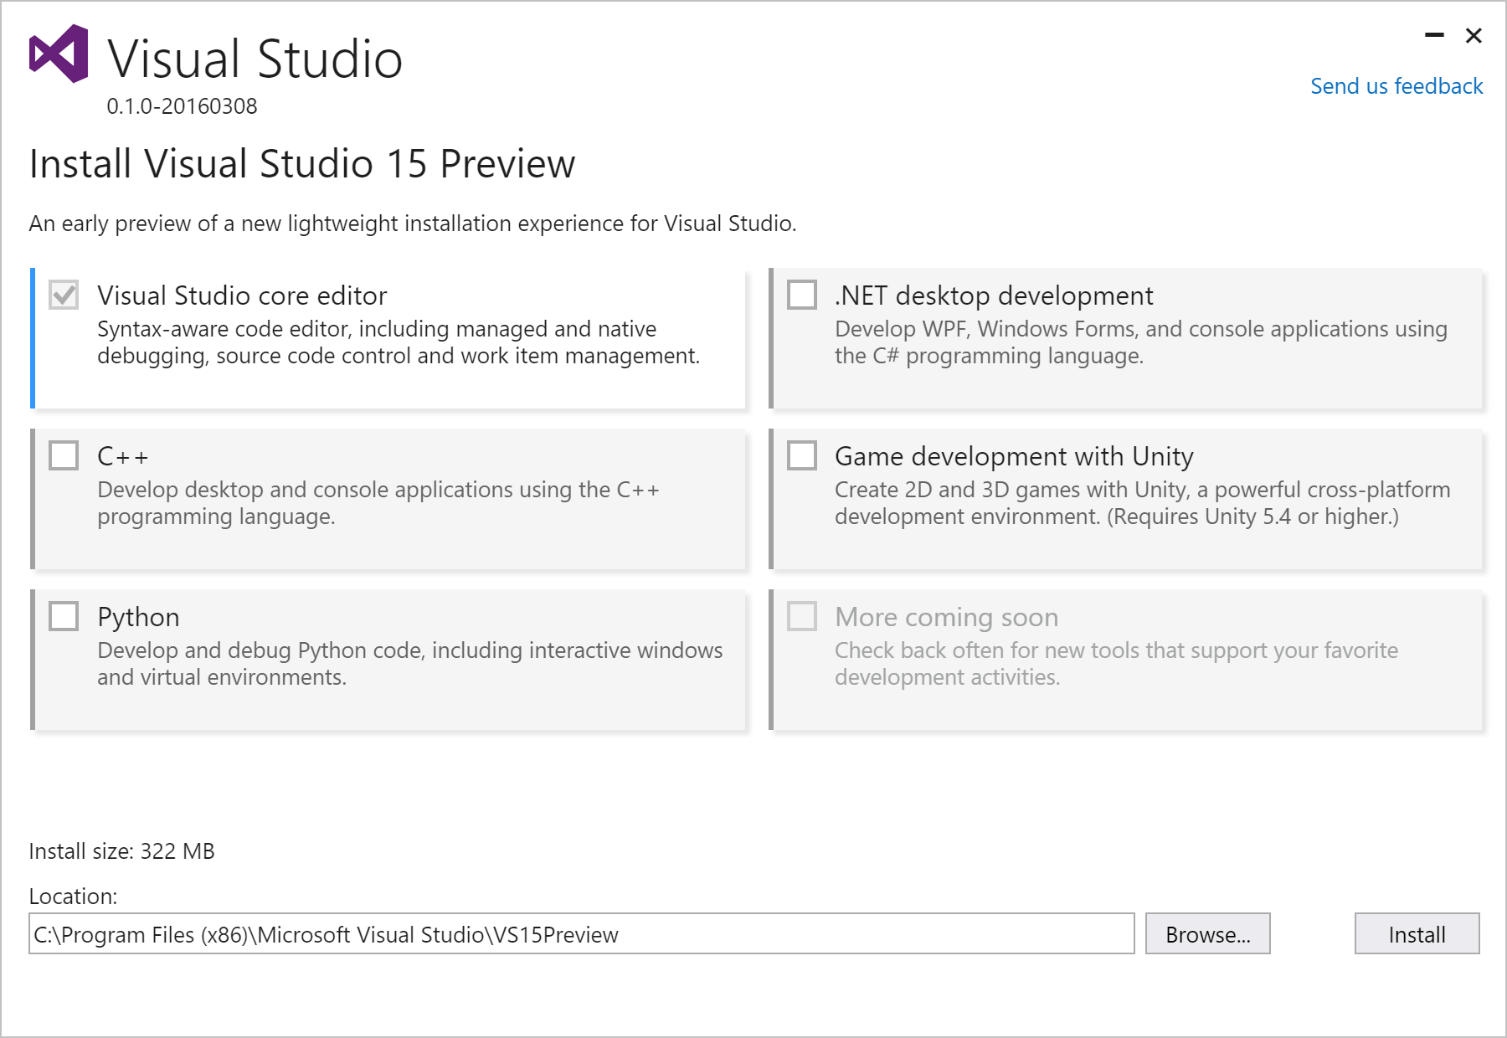
New acquisition experience
Lightweight
Base install 250 MB
Fast
Base install average <180s
Optimized
Installs only what you need
Low impact & isolated
No more MSI and GAC
http://aka.ms/vsnext

Slide 7
Tools and services for any developer, any app
Windows
Linux
iOS
Android
.NET
C++
JavaScript
PHP
Python
Node.js
R
Cordova
Unity

Slide 8
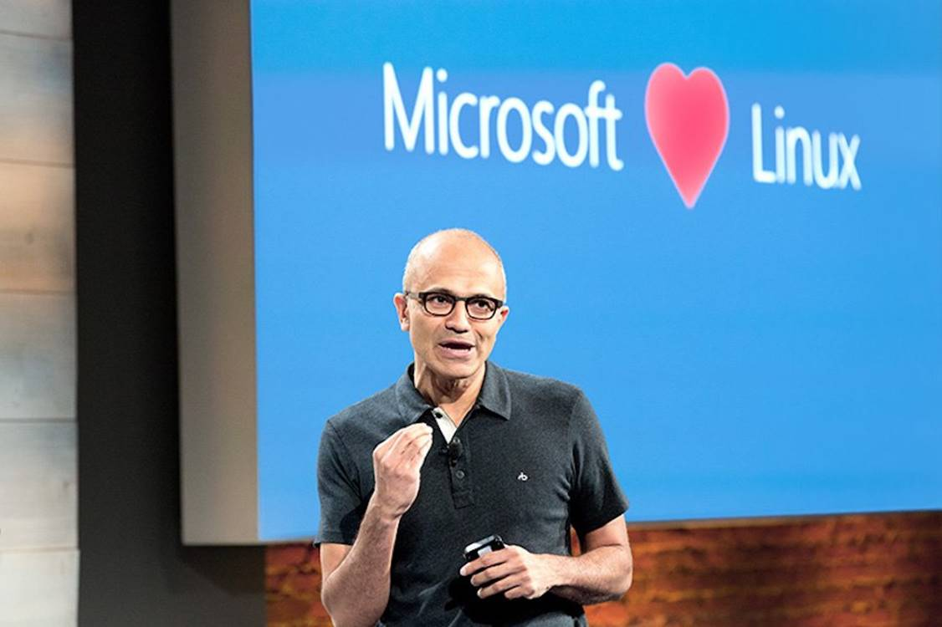

Slide 9
Any Developer Any App

Slide 10
Developer Inner Loop Productivity
Edit
Create and update your code
Diagnose
Fix and optimize your code
Compile
Build your code
Test
Validate your code

Slide 11
Productivity

Slide 12
Developer Inner Loop Productivity
Edit
Create and update your code
Diagnose
Fix and optimize your code
Commit
Share your code
Compile
Build your code
Test
Validate your code

Slide 13
Productivity - Commit

Slide 14
Developer Inner Loop Productivity
Edit
More efficient in writing code
Diagnose
Performance insights and powerful debugging
Commit
Optimized SCC workflow with rich history
Compile
No time wasted waiting for compilation
Test
Quality early and continuous execution

Slide 15
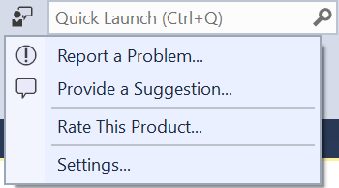
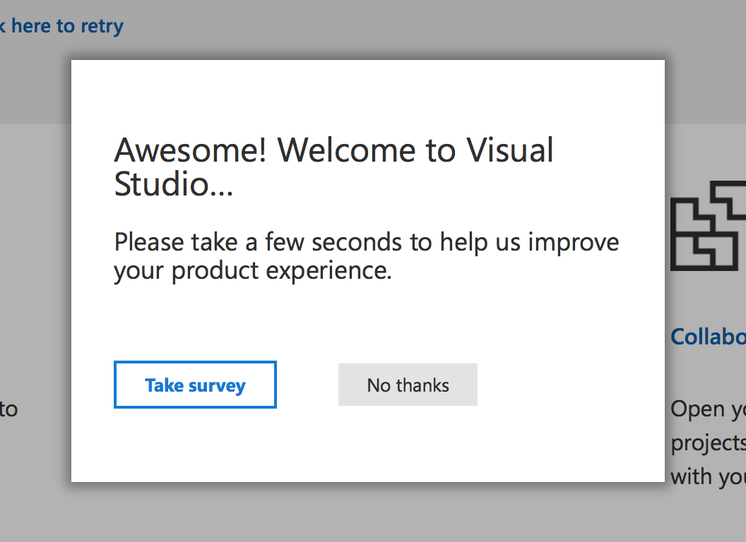
We want to hear from you!
Inside Visual Studio
Outside Visual Studio
Report a problem
“I ran into an issue”
Send a suggestion
“I have a great idea”
Rate this product
“I love Visual Studio!”
Take surveys
“I have more to tell you”
Forums
Social channels
@visualstudio

Slide 16
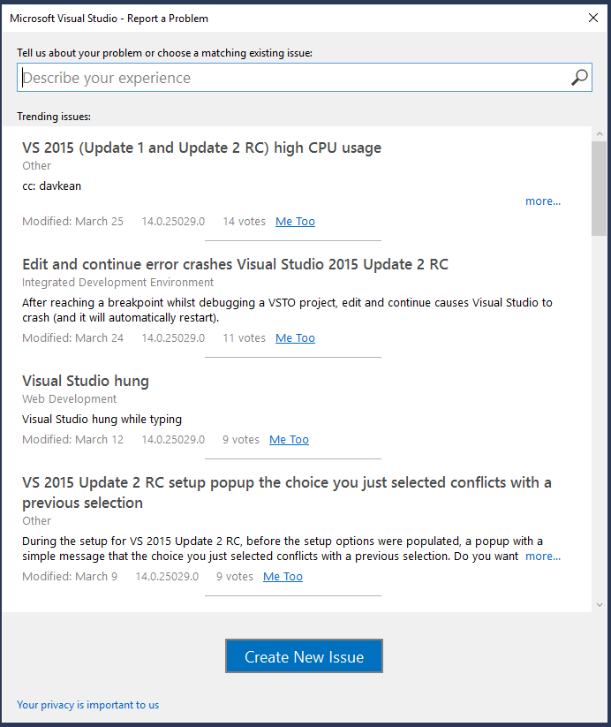
We want to hear from you!

Slide 17
Behind the scenes: UI delay

Slide 18
Future of Visual Studio
Lightweight install, optimized for your dev needs
Any Developer, Any App
Most productive tooling in the industry
Always improving with your feedback

Slide 19
Download Visual Studio “15”
Please provide us feedback!
http://aka.ms/vsnext

Slide 20
Where to go next
Session code | Title | Speaker | Time | Room
B880 (earlier today) | Top 6 Reasons to Move Your C++ Code to Visual Studio 2015 | Ankit Asthana, Andrew Hall, Marian Laparu | 3/30/2016 11:30am | Marriot Salon 6
B886 | Visual Studio 2015 Extensibility | Mads Kristensen | 3/30/2016 5:00pm | Moscone 2005
B836 | Cross-Platform Mobile with Xamarin | Miguel de Icaza | 3/31/2016 2:00pm | Marriott Salon 9
B891 | .NET Overview | Scott Hanselman, Scott Hunter | 3/31/2016 3:30pm | Marriott Salon 9
B889 | The Future of C# | Dustin Campbell; Mads Torgersen | 3/31/2016 6:30pm | Marriott Salon 9
B819 | Become a Visual Studio 2015 Power User | Allison Buchholtz-Au; Andrew Hall | 3/31/2016 6:30pm | Marriott Salon 7
B824 | Building Desktop Apps in Visual Studio vNext | Unni Ravindranathan | 4/1/2016 10:30am | Marriott Salon 8

Slide 21
Please Complete An Evaluation Form Your input is important!
or

