Slide 2
What's New in Windows UI/UX for Universal Windows Apps
B853
Joe Stegman
Group Program Manager

Slide 3
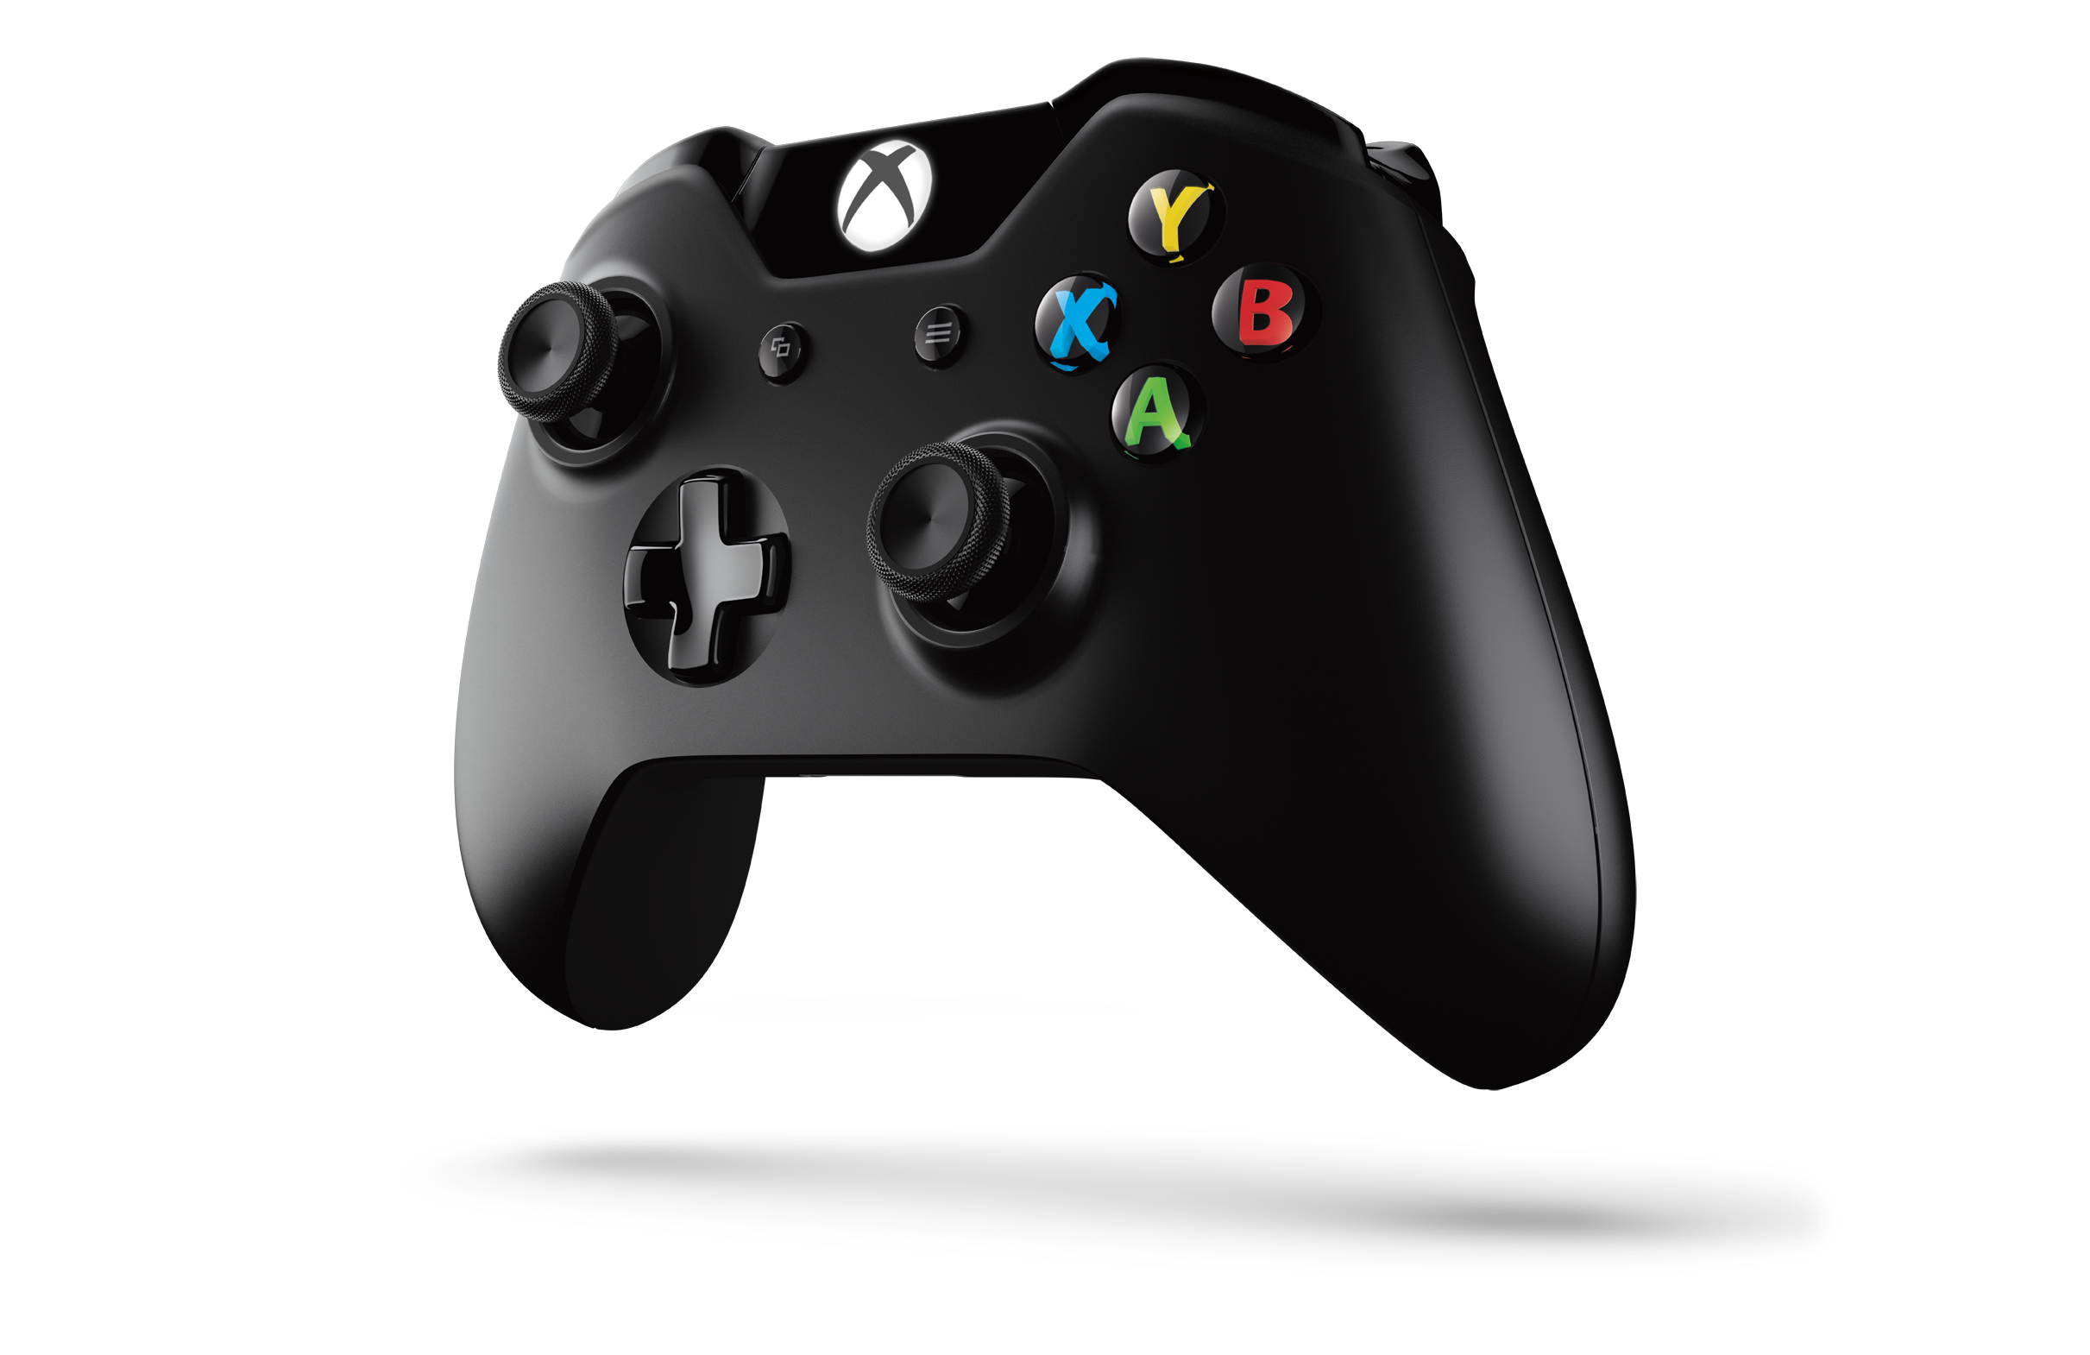
Agenda
Questions?
XAML UI, Bindings and Keyboard Improvements
  Includes features that span XAML UI and Visual Studio
UI/UX: UWAs on Xbox
Beautiful UX: Animations, Effects

Slide 4
Demo:
XAML and Visual Studio
Better Together

Slide 5
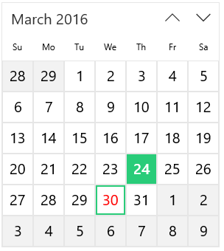

Control Colors in XAML (Today)
XAML Control Colors
Button [PointerOver]
CalendarView [Selection]
Map to ~80 system colors
~80 System Colors
(and Brushes)
SystemBaseHighColor
(SystemControlHighlightBaseHighBrush)

Slide 6
Control Colors in XAML (In Anniversary Update)
XAML Control Colors
Button [PointerOver]
Control Specific Colors
ButtonForegroundPointerOver
~80 System Colors
SystemBaseHighColor
(SystemControlHighlightBaseHighBrush)

Slide 7
Demo:
XAML and Visual Studio
Back to the live demo…

Slide 8

Animated GIF in XAML
Implicit with Image and BitmapImage
<Image Source="rain.gif""/>
<!-- Or -->
<Image>
<Image.Source>
<BitmapImage x:Name="rain" UriSource="rain.gif"
AutoPlay="False"/>
</Image.Source>
</Image>
// Start manually
Rain.Play();

Slide 9
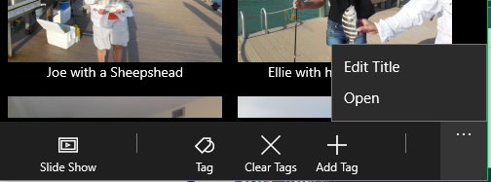
CommandBar Dynamic Overflow
Implicit with CommandBar
<!-- Disable with IsDynamicOverflowEnabled -->
<CommandBar IsDynamicOverflowEnabled="True" DynamicOverflowItemsChanging="…">
<!-- Set overflow order -->
<AppBarButton x:Name="Open" Label="Open" DynamicOverflowOrder="1"/>
<AppBarButton Label="Edit…" DynamicOverflowOrder="2"/>
<AppBarSeparator/>
<AppBarButton Label="Add…"/>
<…/>
</CommandBar>
// Use IsInOverflow to check state
bool overflowed = Open.IsInOverflow;

Slide 10
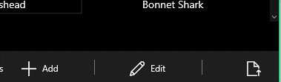
CommandBar Customization
Use OverflowButtonVisibility and [Default]LabelPosition:
<!-- Auto hide overflow visibility button -->
<CommandBar DefaultLabelPosition="Right" OverflowButtonVisibility="Auto">
<…/>
<AppBarButton Label="Add"/>
<AppBarSeparator/>
<AppBarButton Label="Edit"/>
<!-- Set explicit label position on per button basis-->
<AppBarButton Label="Open" LabelPosition="Collapsed"/>
</CommandBar>

Slide 11
UWAs on Xbox

Slide 12
Developing UWAs for Xbox One
Optimize for 10’ viewing distance
      Size for TV Layout
      TV safe area TV safe colors
Optimize for gamepad input
      XY Focus High visibility focus visuals
      Engagement Mouse mode
Delight the living room
      Multi-user Sound
More info
      B883: Building great apps for Xbox with the Universal Windows Platform
      Thursday 5pm in Marriott 8
Will touch on these. For details, see this.

Slide 13
Demo:
Xbox One Related Features
(in UWAs)

Slide 14

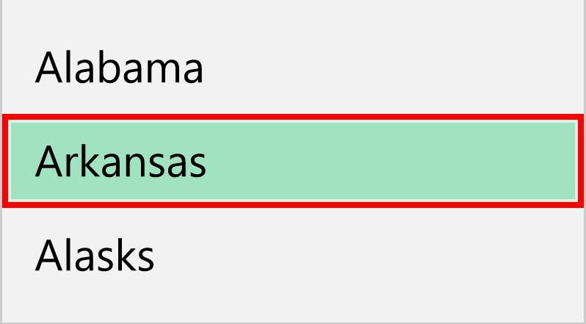

High Visibility Focus Indicators
Implicit and configurable:
New FrameworkElement properties
FocusVisualMargin
FocusVisualPrimaryBrush
FocusVisualPrimaryThickness
FocusVisualSecondaryBrush
FocusVisualSecondaryThickness
[Red]
[Black]
// To use “dotted line” focus (default is HighVisibility)
Application.Current.FocusVisualKind = FocusVisualKind.DottedLine;

Slide 15
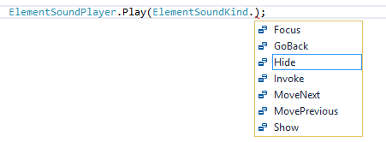
Xbox One Sounds In UWPs
Implicit on Xbox One
// Auto is the default. Will be on for Xbox One, Off elsewhere
ElementSoundPlayer.State = ElementSoundPlayerState.Auto;
Use ElementSoundPlayer to explicitly play sounds:

Slide 16
UWPs on Xbox One (new UI APIs)
FrameworkElement:
AllowFocusOnInteraction
AllowFocusWhenDisabled
Control:
FocusDisengaged
FocusEngaged
IsFocusEngaged
IsFocusEngagementEnabled
RemoveFocusEngagement
RequiresPointer
XYFocusDown, XYFocusLeft, XYFocusRight, XYFocusUp
Popup:
LightDismissOverlayMode
Gamepad Engagement Mode and Model
Gamepad Navigation
“Smoke” Visual Affordance

Slide 17
Demo:
More UI/Framework Improvements

Slide 18
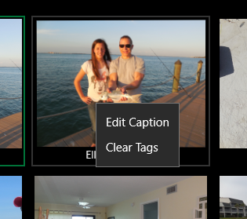
New Context Menu APIs
Use ContextFlyout property and ContextRequested event
<Image ContextRequested="Menu_Handler"/>
<!-- Markup – no code required -->
<Image>
<Image.ContextFlyout>
<MenuFlyout>
<MenuFlyoutItem Text="Edit" …/>
<MenuFlyoutItem Text="Clear" …/>
</MenuFlyout>
<Image.ContextFlyout>
</Image>
<!– Works for Mouse, Touch, Gamepad -->

Slide 19
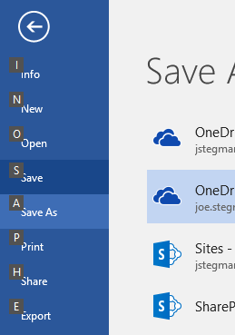
Keyboard Mnemonics
Use AccessKey property and new events on UI/Text elements
<!– ALT + O will invoke the Button -->
<Button Content="Open" Click="OpenCmd" AccessKey="O" AccessKeyDisplayDismissed="OnDismissed" AccessKeyDisplayRequested="OnDisplayed"/>
// Display UX Affordance (not required)
private void OnDisplay(…)
{
// If desired: show all commands and UX affordance
// Example: show tooltip and hide in “OnDismissed” handler
var tooltip = ToolTipService.GetToolTip(sender) as ToolTip;
…
}

Slide 20
Compiled Binding Improvements

Slide 21
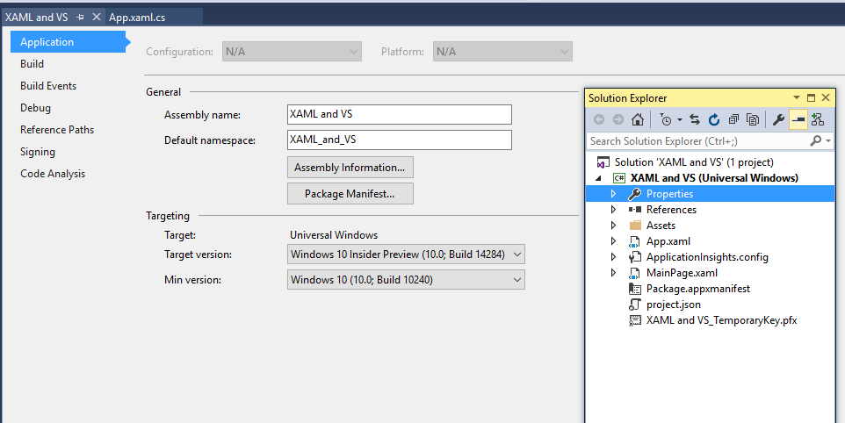

Updating an Existing App/Project
Must target latest SDK to use new compiled binding features

Slide 22
Compiled Bindings
Function Binding
  Called as part of binding expression, supports change notification
  Scenarios: converters and multi-bindings
  Text="{x:Bind GetTags(VM.Item.Title, VM.Item.Tags)}"
Supports dictionaries
  Text="{x:Bind File.Properties['Artist'].Name}"
Supports C# style casts
  Text="{x:Bind ((Movie)VM.Item.Director)}"

Slide 23
Animations and Effects
Exposed via the Visual Layer

Slide 24
UI Framework Layering
Framework layer
Controls, layout, markup, accessibility, data binding
Windows.UI.XAML
Visual layer
Visuals, Animations & Expressions, Effects, Input Routing & Manipulations
Windows.UI.Composition
Graphics layer
Text rasterization, shapes & vector rasterization, ink rendering
DirectX Family

Slide 25
Demo:
Effects and Animations

Slide 26


More Information:
B818: Creating Beautiful UX in a real-world App
James Clarke and Tim Heuer
Thursday, 3:30 PM

Slide 27
Other Notable UI/UX Features

Slide 28
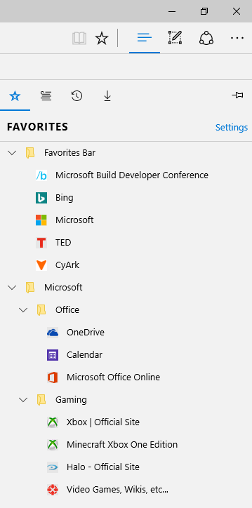
TreeView (via GitHub sample)
Powers Microsoft Edge Favorites
Supports
  Expanding/Collapsing of Nodes
  Drag and Drop
  Accessibility

Slide 29

ComboBox type ahead
Implicit with ComboBox
<!-- Set IsTextSearchEnabled to False to disable -->
<!-- Works if when ComboBox has focus (either spung or collapsed -->
<ComboBox IsTextSearchEnabled="True" x:Name="StatesComboBox">
<!-- ComboBox items (or data bound) -->
<…/>
</CommandBar>
User Types: wy

Slide 30
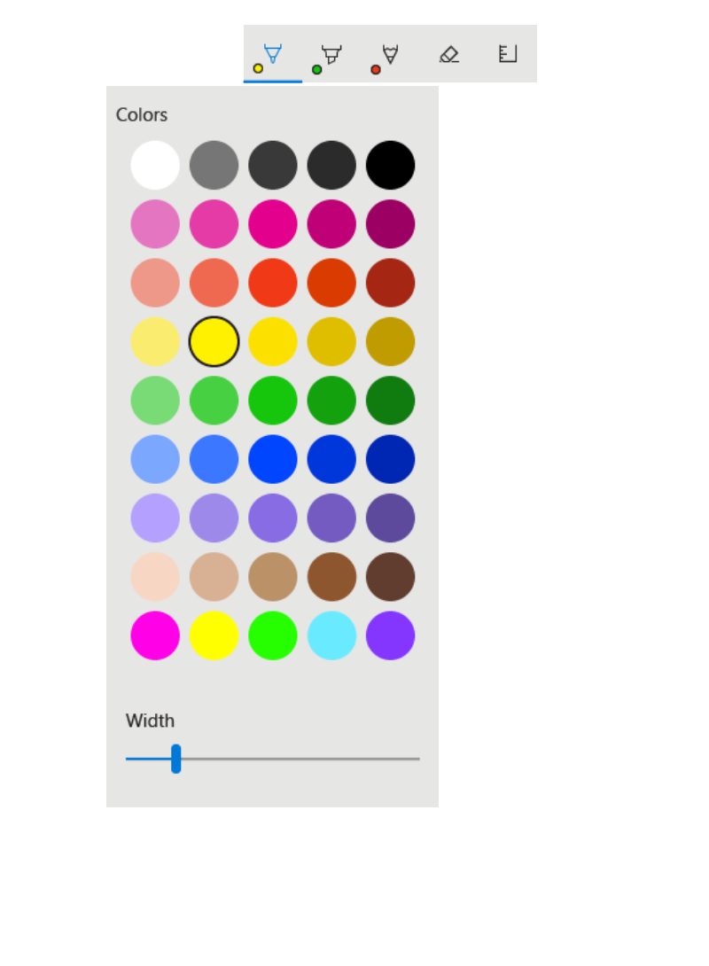
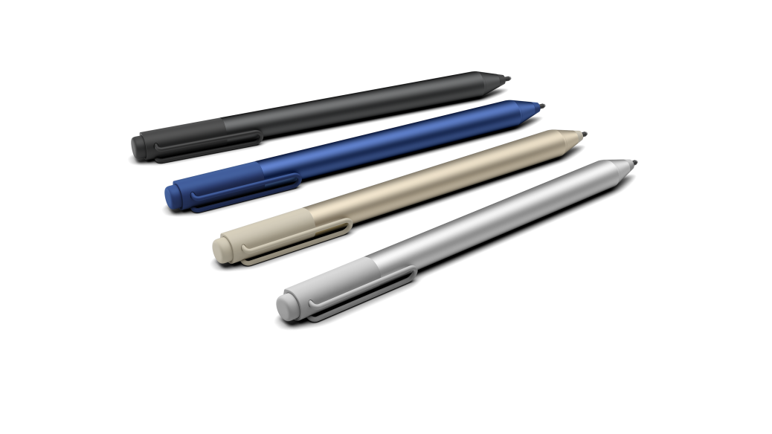
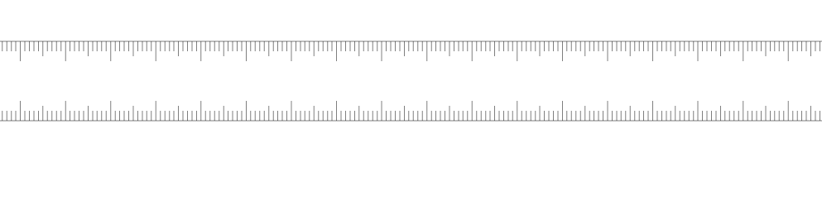
Unleash the power of Ink in your Apps
    Ink is enabled in just one line of code!
    Ink Toolbar and Ruler in just one more
    Simultaneous Pen and Touch – Ruler is just the start!
    Flexible tools and platform - add your own personal touch
    Microsoft is investing in Windows Ink and now its your turn!

Slide 31

MediaPlayerElement
Powered by underlying WinRT media engine
  Windows.Media.Playback.MediaPlayer
Key new features:
  Play background video and audio from a XAML control
  Auto connect to system media controls
  Direct access to MediaPlayer object

Slide 32
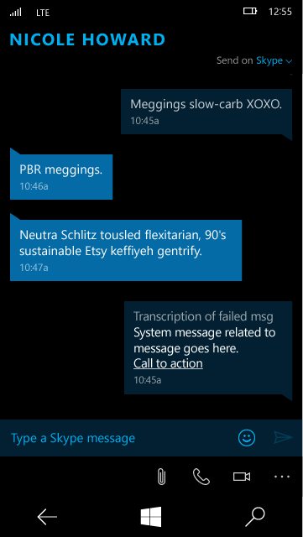
Bottoms-Up Lists ListView
Use ItemsUpdatingScrollMode on ItemsStackPanel
<!– New items fill from bottom-up -->
<ListView.ItemsPanel>
<ItemsPanelTemplate>
<ItemsStackPanel
ItemsUpdatingScrollMode="KeepLastItemInView"
VerticalAlignment="Bottom"/>
</ItemsPanelTemplate>
</ListView.ItemsPanel>

Slide 33

Other New APIs and Features
APIs
FrameworkElement
AllowFocusOnInteraction
AllowFocusWhenDisabled
InputScopeNameValue
ChatWithoutEmoji
ListViewBase
SingleSelectionFollowsFocus
OrientedVirtualizingPanel
GetInsertionIndexes
Pivot
HeaderFocusVisualPlacement
IsHeaderItemsCarouselEnabled
Other UI/UX Improvements
Drag and Drop into a Folder
Improved text performance
DateTime Picker Improvements
Flyouts in Flyouts
MSDN Documentation

Slide 34
Call to Action
Use this slide to list resources, white papers,
videos and links.
Let attendees know their next step
after seeing this session.
Re-visit Build on Channel 9.
Continue your education at
Microsoft Virtual Academy online.

Slide 35
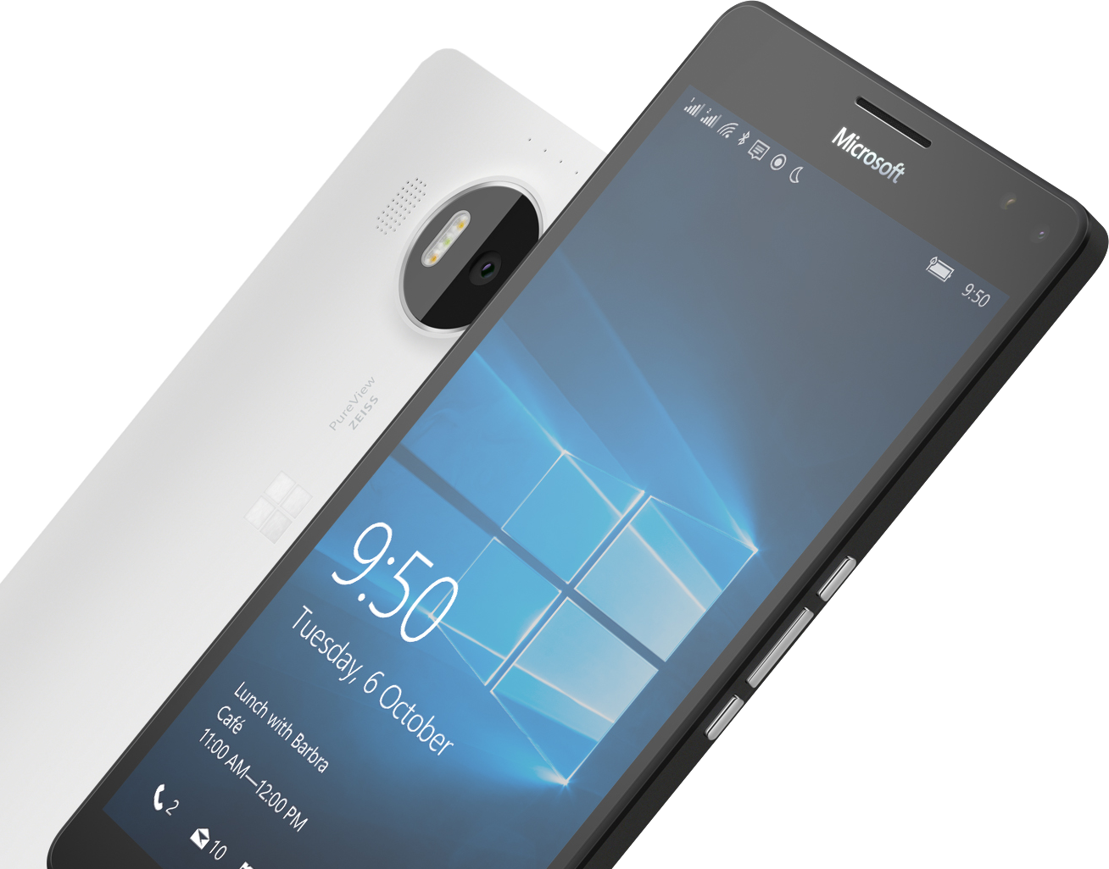


Please Complete An Evaluation Form
Your input is important!
or

Slide 36
Questions?

