Slide 2
Enabling DevOps for Every Team
B845
Donovan Brown – Senior Program Manager
Jeremy Epling – Principal Program Manager

Slide 3


Who am I?
Donovan Brown | @DonovanBrown
Senior Program Manager for DevOps
Blog at DonovanBrown.com
Technical YouTube Channel
  tinyurl.com/DonovanBrown
Fun Stuff
Professional Air Hockey player
  Highest ranking 11th in the world
Competitive driver
Developer for over 20 years

Slide 4

Who am I?
Jeremy Epling
Principal Program Manager for Git and Version Control
Worked on OneDrive, Windows, and Office
Fun Stuff
Husband and dad
My son started walking yesterday!
Avid rock climber – mainly bouldering
Designing apps and coding since I taught myself in High School

Slide 5




Visual Studio
Team Services
Open, flexible, and extensible
cross-platform DevOps tools
Unlocks a greater ecosystem and
works with what you already use
Team Foundation
Server
More agility and flexibility for continuous value delivery

Slide 6

Visual Studio Team Services
Code Repository
Build + Deploy
Automated Testing
User Feedback
Backlog
Monitor and improve

Slide 7
Visual Studio Team Services is Enterprise Ready
Compliance
Data Sovereignty
Data Import
Active Directory
Process Customization
Code Search
Reporting

Slide 8
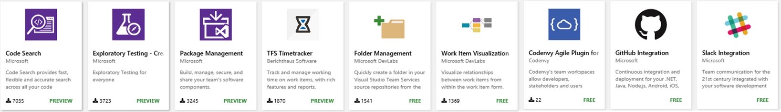
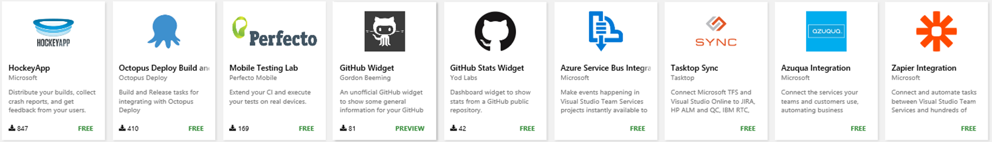
Available for Team Foundation Server with Update 2
Visual Studio Marketplace
920
Visual Studio Code Extensions
5,910
Visual Studio
Extensions
100
Visual Studio Team Services Extensions

Slide 9

Demo
Edith Harbaugh
CEO, LaunchDarkly
Booth 406
launchdarkly.com/microsoft

Slide 10




End-to-end DevOps
1
4
Plan + Track
Monitor + Learn
Development
Production
2
3
Develop + Test
Release

Slide 11

Plan + Track
It starts with an idea - and a plan how to turn this idea into reality…
Project starts
Manage work
Develop + Test
1
Track progress
Plan

Slide 12
Agile
Dashboards & Charts
Backlogs & Kanban Boards w/ formatting
New Work Item Form
Social workflows with @mentions
Customizable Agile Processes
Dev+Test integration

Slide 13
Demo
Agile

Slide 14

Develop + Test
After the iteration starts, developers turn great ideas
into features and functionality …
2
Write Code
Unit Testing
Version Control
Build
Build Verification
Release

Slide 15
Git and Version Control
E2E DevOps Traceability
Cross-platform with IDE plug-ins
Social Code Reviews
Semantic Code Search
Seamless Integration with Visual Studio

Slide 16
Demo
Git and Version Control

Slide 17
Testing
Full integration with Build and Release Management
Code Coverage support for Java
Parallel Execution
Exploratory Extension

Slide 18
Demo
Test

Slide 19
Continuous Integration
Cross-platform
Open Source
Extensible

Slide 20
Package Management
Enterprise authentication
Private hosted feeds for your enterprise
Discover and search for packages across an enterprise
Seamless integration with Build and Release Management
Plans to support additional package types

Slide 21
Demo
Continuous Integration & Package Management

Slide 22


Release
When all tests pass, the build is deployed
to testing environments for each
stage in the release process …
Cloud
Load Testing
Integration testing
environment
Staging
environment
3
Monitor + Learn
Automated functional testing environment
Pre-production environment

Slide 23
Release Management
Enables Continuous Delivery
Parallel deployments
Deploy to Cloud, On-premises data centers
Integration and traceability throughout Team Services
Coming to TFS in Update 2

Slide 24
Demo
Release Management

Slide 25

Demo
Steve Jones
Technical Evangelist, Red Gate
Booth
aka.ms/RedGateReadyRoll

Slide 26

Monitor + Learn
When all tests pass, the build is deployed to testing environments for each stage in the release process
Plan the next iteration
Feedback
Monitor
4

Slide 27
Monitor and Learn
Mobile DevOps with HockeyApp
  B869: Mobile DevOps with HockeyApp and Visual Studio Team Services
  Friday @ 9:00AM
Analytics with Application Insights
  B838: Deep Diagnostics for Web Apps & Services with Application Insights
  Friday @ 12:30PM

Slide 28
Roadmap

Slide 29
Roadmap for the next 1-3 months
Change Work Item Type
More Agile Process Customization
Redesigned Branches Hub with GitFlow
NPM Support for Package Management
Release Management REST APIs and Service Hooks
Import from Team Foundation Server GA

Slide 30

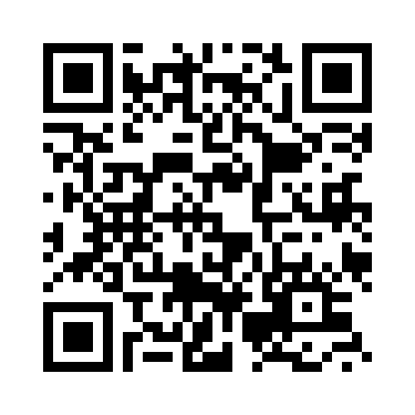

Please Complete An Evaluation Form
Your input is important!
or

Slide 32
Q&A with Speakers
After Session

