Slide 2
Demystifying App Development on Azure
B841
Corey Sanders
Director of Azure Compute

Slide 3
The cloud is changing expectations.

Slide 4
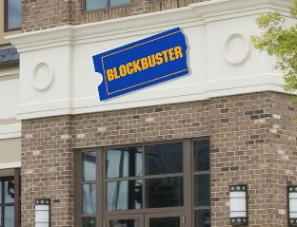


Every company is a software company

Slide 5




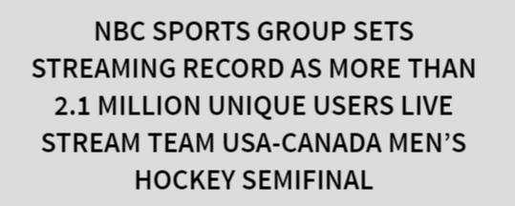
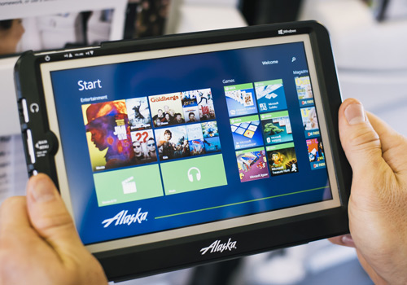
Every company is a software company

Slide 6

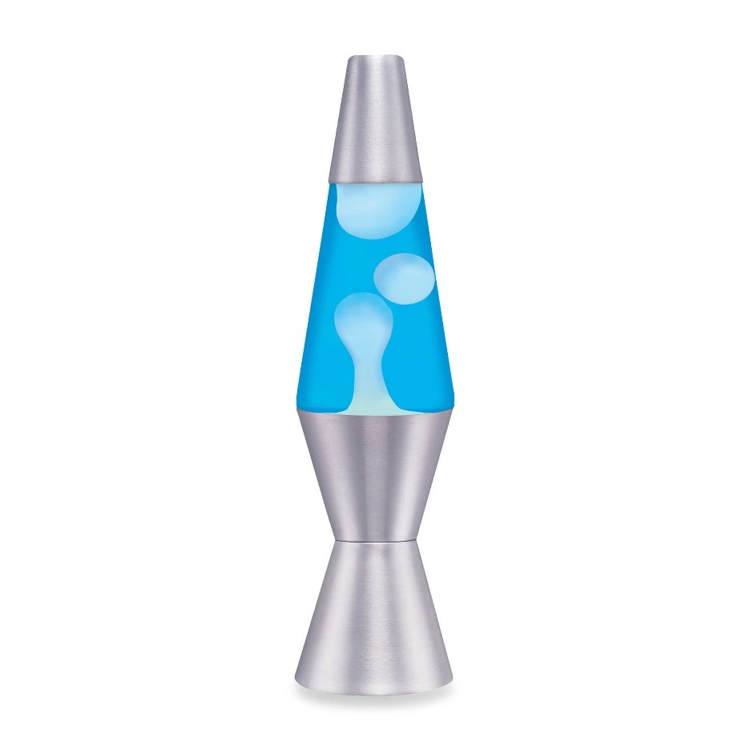
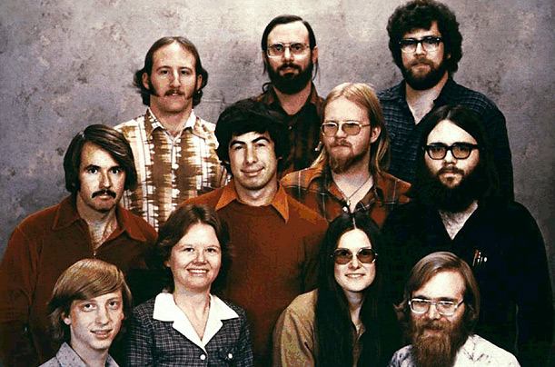
Developer-focused innovation runs deep

Slide 7
What are app developers looking for?

Slide 8
Agility

Slide 9
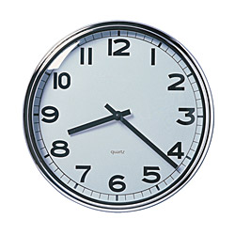
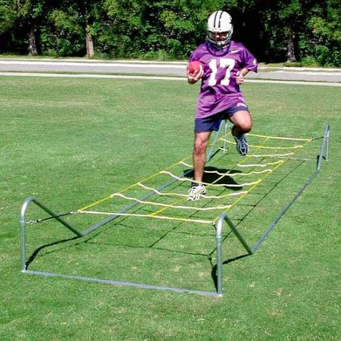
What is agility?
Dev
Test
Deploy
Learn

Slide 10
Agility

Slide 11
Hyper-Scale
Availability
Agility

Slide 12
Hyper-Scale
Availability
Agility

Slide 13

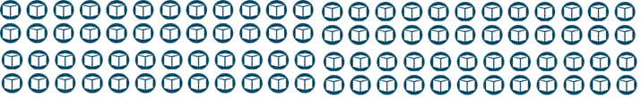
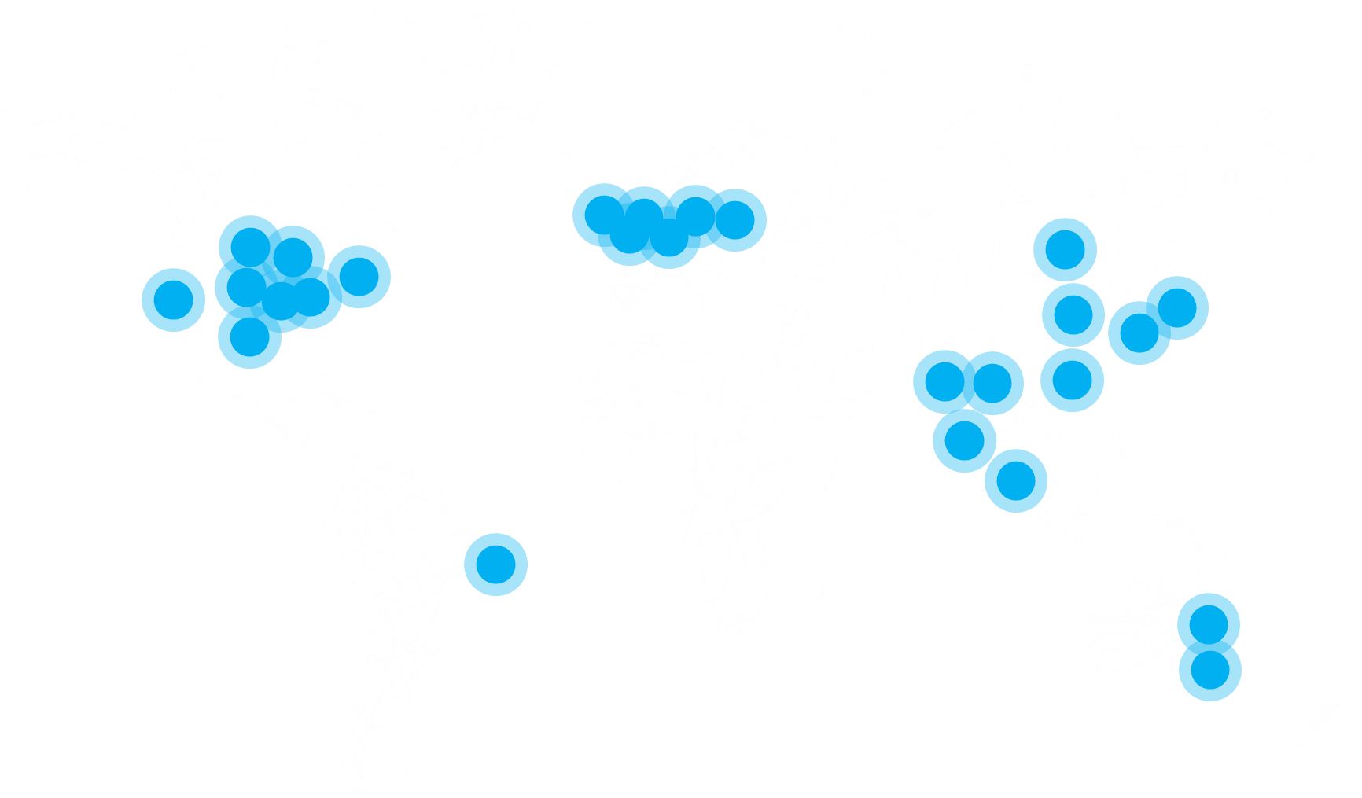
Application Automated Scale
Hyper-Scale
Container Scale
Global Scale

Slide 14
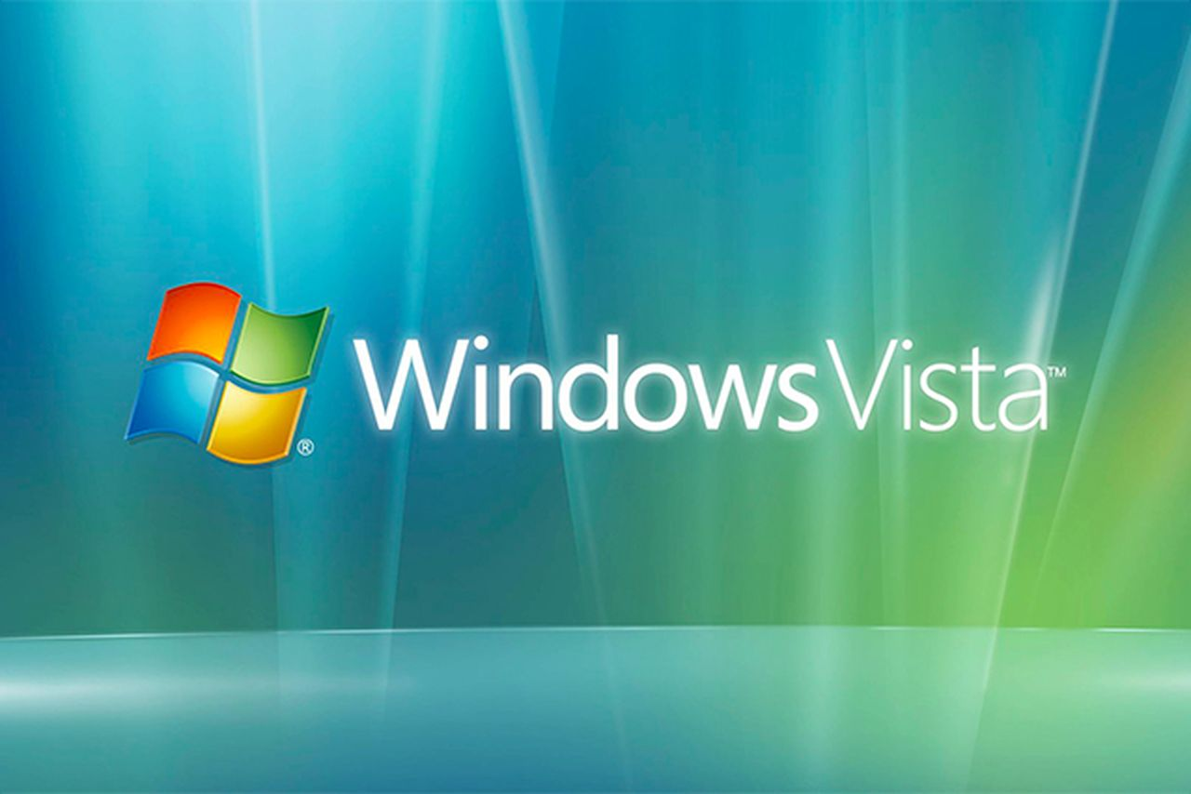
Resilient to infrastructure failure
Availability
Resilient to application failure

Slide 15

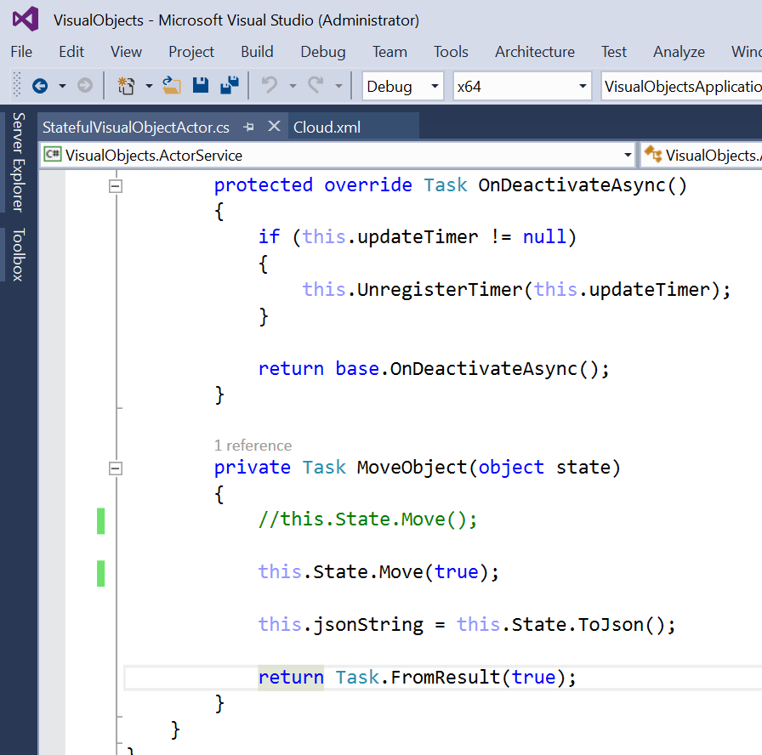




Simple tooling integration
Services to help
Simple application platforms
Agility

Slide 16
A vast amount of choice…

Slide 17
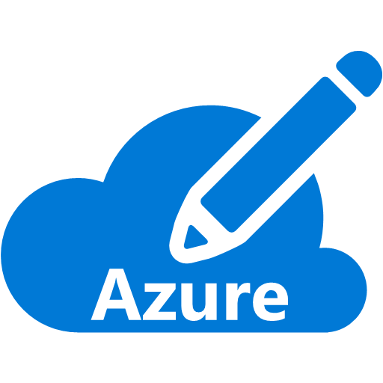






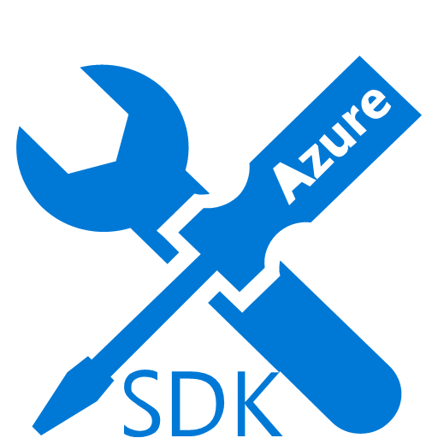

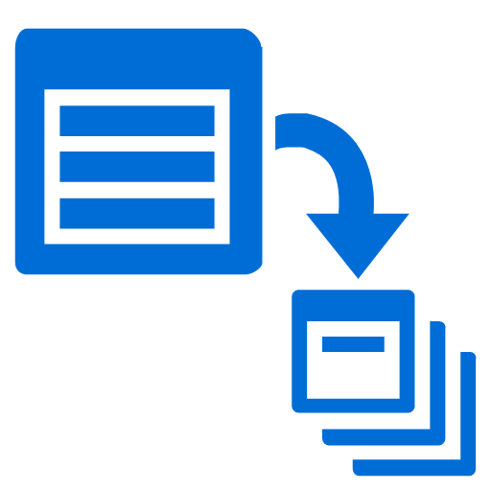

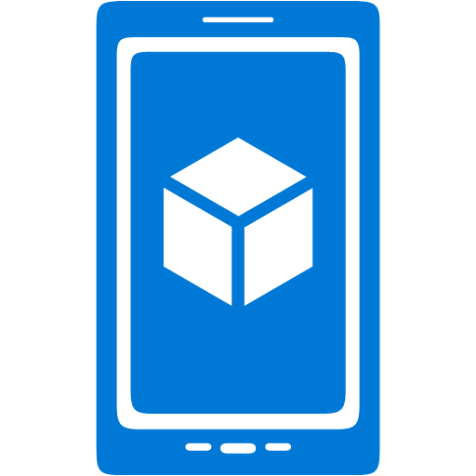












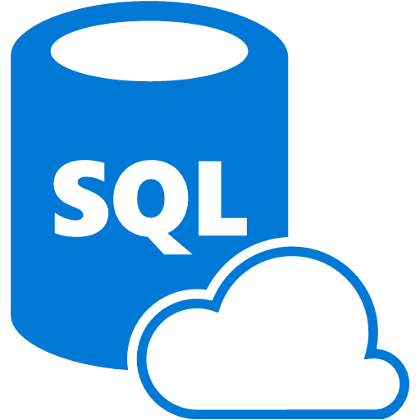



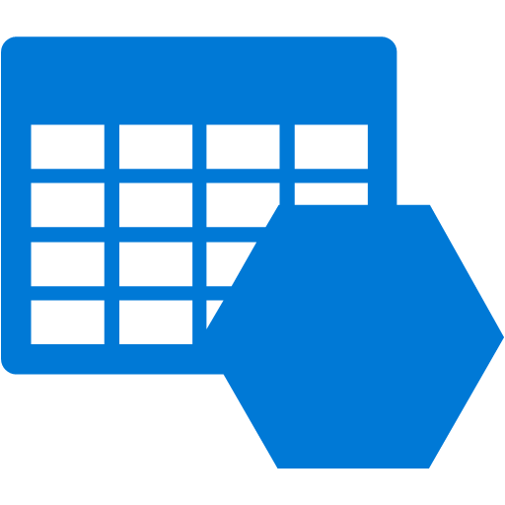









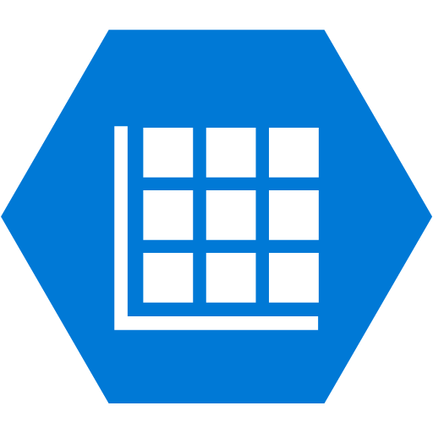




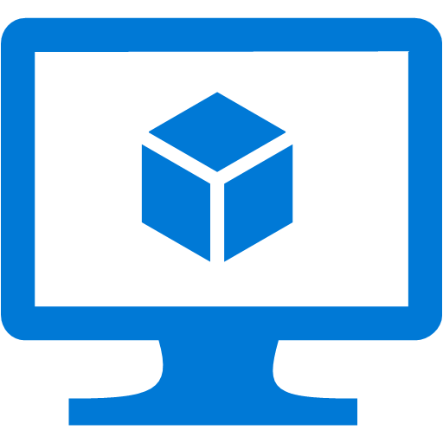







Security & Management
Platform Services
Hybrid Operations
Portal
Compute
App Service
Developer Services
Azure AD
Connect Health
Cloud
Services
Service
Fabric
Web
Apps
API
Apps
API
Management
Visual Studio
Azure SDK
Active
Directory
AD Privileged
Identity Mngt
Batch
Remote App
Mobile
Apps
Logic
Apps
Notification
Hubs
Team Project
Application
Insights
Multi-Factor
Authentication
Backup
Integration
Analytics & IoT
Data
Automation
Operational
Insights
Storage
Queues
Biztalk
Services
SQL Data
Warehouse
HDInsight
Machine
Learning
SQL
Database
Key Vault
Hybrid
Connections
Service
Bus
Import/Export
Store /
Marketplace
Data
Factory
Event
Hubs
Redis
Cache
Search
Media & CDN
Site
Recovery
Stream
Analytics
Mobile
Engagement
DocumentDB
Tables
VM Image Gallery
& VM Depot
Media
Services
Content Delivery
Network (CDN)
StorSimple
Infrastructure Services
Compute
Storage
Networking
Windows
Linux
Containers
BLOB Storage
Azure Files
Premium Storage
Virtual Network
Load Balancer
DNS
Express
Route
Traffic Manager
VPN Gateway
Application Gateway

Slide 18
The Azure Application Platform
Preview
GA
“App Creators”
Developers
Non-Devs
Build on infrastructure (IaaS)
Build on Dev framework (PaaS)
Existing App Investments
Differentiation Time to value
Virtual Machines
VM ScaleSets
Container Service
Batch
Cloud Services
Service Fabric
App Service
Power Apps
Environments
Web/Mob/API
Logic
Stateful and stateless one-off solutions
Scalable stateless solutions
Scalable, orchestrated Docker images deployed into containers
Custom High Performance Computing solutions
Custom Monolithic 3-tier stateless solutions
Custom Microservice-based stateless and stateful solutions
All the goodness of App Service in a dedicated environment
Template based rapid development web, mobile and API solutions
Orchestrated workflow based integration solutions
Graphical design mobile solutions
Lift & Shift
Docker
SaaS
LOB
Microsoft Azure

Slide 19

IaaS
VMs and ScaleSets
Raw
Containers

Slide 20
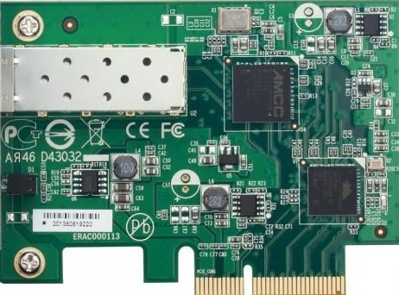
VMs and VM Scale Sets
Corey VM
Mark VM
Corey vNIC
Corey Storage
Mark vNIC
Mark Storage

Slide 21
VMs and VM Scale Sets
VM 1
VM 2
VM 3
VM 4
VM 5
VM 5

Slide 22
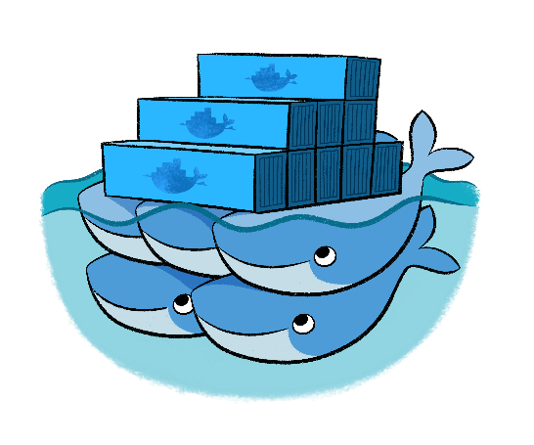


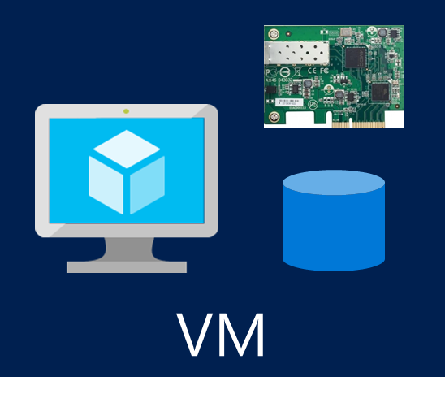
Azure Container Service

Slide 23

Web/Mobile
Serverless
PaaS
Existing Frameworks
Microservices
IaaS
VMs and ScaleSets
Raw
Containers

Slide 24
Serverless
Event-driven compute application components.
Ex: IOT events, game events, operational events
Web and mobile fully managed applications. No infra management.
Ex: ecommerce sites, LOB sites, supporting websites
Web/Mobile
Microservices
Massive-scale, 24x7 available applications with agile multi-components.
Ex: Multi-part live games, queuing systems, large-scale sites/LOB
Existing Frameworks
Applications focused on the framework/runtime/application model.
Ex: Existing enterprise/LOB apps, new scale-out with existing components

Slide 25


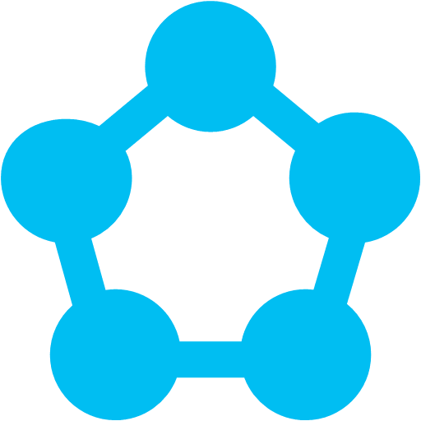
Serverless
Azure Functions
App Service
Web/Mobile
Microservices
Service Fabric
Existing Frameworks
Cloud Services

Slide 26
Cloud Services

Slide 27


Cloud Services
Code
Config
PaaS with VM control
Simple .NET runtime
Health, Discovery, Updates
OS Patching
Cloud Service
Web roles
Worker roles
Azure Storage

Slide 28
Service Fabric

Slide 29
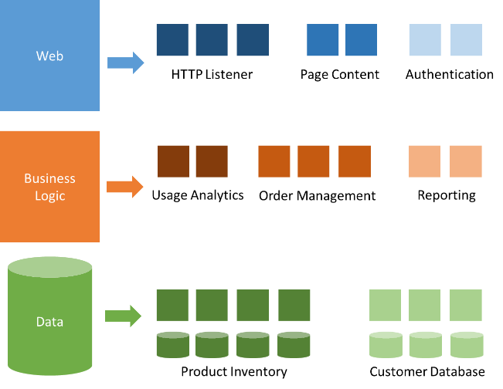
Modernization with microservices
Individually built and deployed
Small, independently executing services
Integrate using published API calls for overall application’s functionality
Fine-grained, loosely coupled application

Slide 30
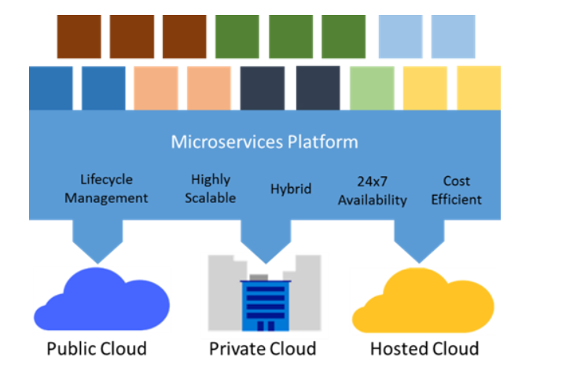
Azure Service Fabric
Microservices Platform
Manage microservices at scale
CI/CD pipeline endpoint
24x7 service availability
Stateful services
Containers & Docker
Multi-Cloud
Service Fabric

Slide 31
Demo
Service Fabric

Slide 32


Microservices Stacking
Prescriptive microservices platform
Service Fabric
Composable platform

Slide 33
App Service

Slide 34


Azure App Service
Build and scale great Web and mobile apps
Web apps
Mobile apps
Logic apps
API apps
Auto-patching and auto-scale
.NET, Java, Node.js, PHP, Python
Integrate with SaaS and on-premises
Continuous integration with VSTS, Github, BitBucket, and more

Slide 35
Demo
App Service
Nir Mashkowski

Slide 36
Azure Functions

Slide 37



Code
Azure Functions
Events + data

Slide 38
Respond to any event
Develop your way
Integrated DevOps
Pay for what you use
Fully open source
Azure Functions

Slide 39
Demo
Azure Functions
Nir Mashkowski

Slide 40
Putting it all together…
The true power of choice

Slide 41
A simple Web App
Azure Active Directory
Azure Web App
Azure SQL Database

Slide 42
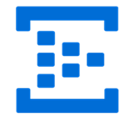
Scale your Web App
Traffic Manager
Redis Cache
Redis Cache
Azure Event Hub

Slide 43
Web, Mobile and API Services
Azure API App
Azure Mobile App
Azure Web App
Notification Hubs
Table Storage

Slide 44



Web App
Media Services
API App
Key Vault
Active Directory
Batch
Service Fabric
Virtual Machines
Virtual Network

Slide 45
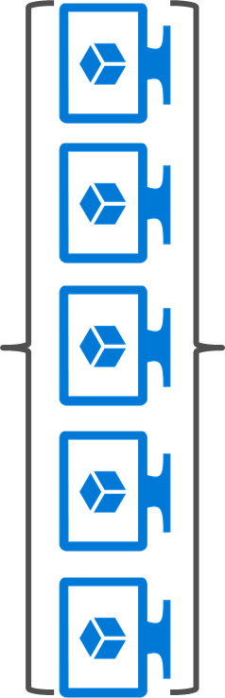
An ecommerce site to the fullest
Azure Web App
Service Fabric
Redis Cache
Azure Event Hub
Azure
ML
Table Storage
Azure API App

Slide 46
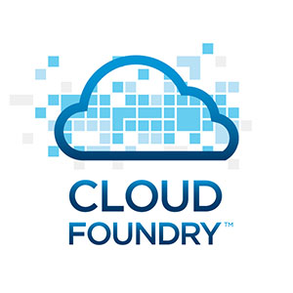

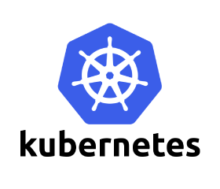
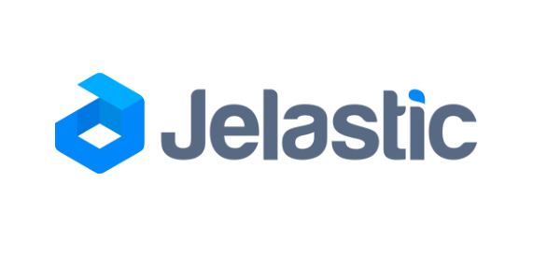
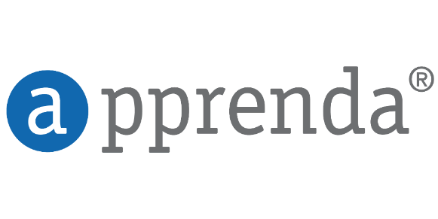
Even more choice…

Slide 47
Choice
Agility

Slide 48
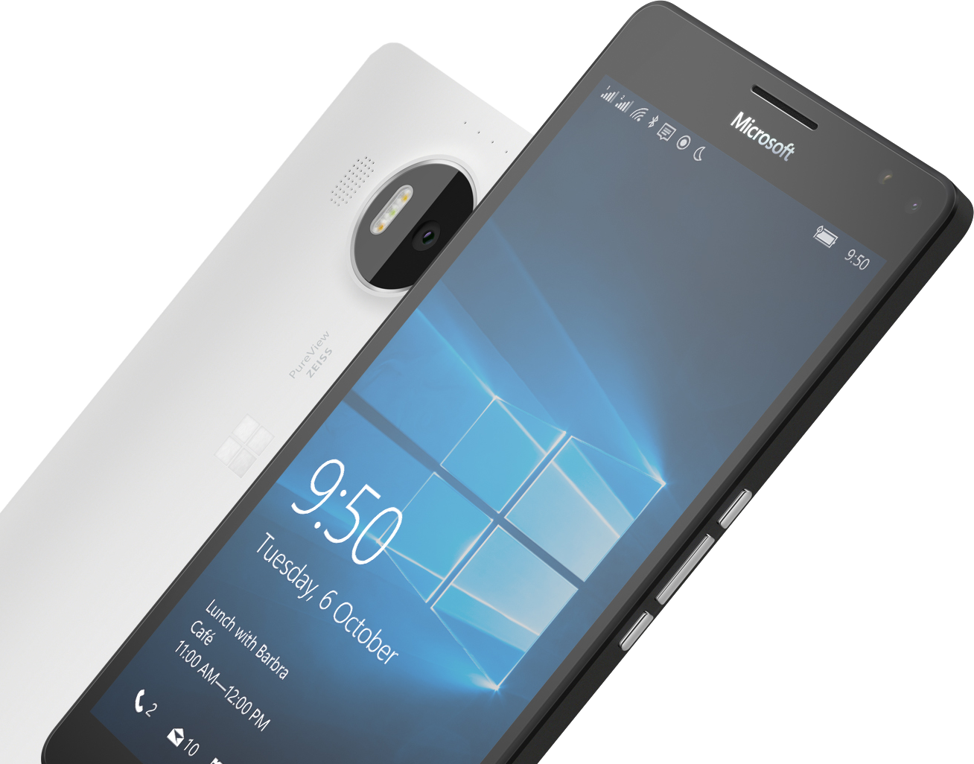


Please Complete An Evaluation Form
Your input is important!
or

