Slide 2
Debugging Tips and Tricks for .NET Developers with Visual Studio
B806
Kaycee Anderson
Program Manager
Kaycee.Anderson@microsoft.com (@KayAnd2014)

Slide 3
“Everyone knows that debugging is twice as hard as writing a program in the first place. So if you're as clever as you can be when you write it, how will you ever debug it?”
Brian Kernighan, Computer Scientist
“As soon as we started programming, we found to our surprise that it wasn't as easy to get programs right as we had thought. Debugging had to be discovered. I can remember the exact instant when I realized that a large part of my life from then on was going to be spent in finding mistakes in my own programs.”
Sir Maurice Wilkes, Computer Scientist

Slide 4
Agenda
Welcome
Demos (50 mins)
30+ Tips and Tricks in Visual Studio 2015
2 New Things in Visual Studio “15” Preview
Resources

Slide 5
Demo #1
Project Properties Launch Options
Start with Stepping
Return Values
Set Next Statement
Step Into Specific
Run to Cursor
Edit and Continue
Step Out
Run to Cursor from Call Stack
Debug a Method from the Immediate Window

Slide 6
Demo #2
Debugger.IsAttached
Debugger.Break
Visualizers (6)
Peek Definition (Alt + F12)
DebuggerDisplay Attribute
DataTips
Transparency
Pinning
Make Object ID

Slide 7
Demo #3
Conditional Breakpoints
Lambda Debugging
Immediate Window
Multiple Project Launch
Restart
PerfTips
Diagnostic Tools window
Memory tool
CPU tool
Attend Become a Visual Studio Power User, March 31 6:30pm

Slide 8
Demo #4
Diagnostic Tools Window
IntelliTrace Events
Historical Debugging
Exception Settings
Call Stack window
Async Call
Show Parameter Values
Show External Code
New Exception Helper (Visual Studio “15” Preview)
Conditions on Exceptions (Visual Studio “15” Preview)

Slide 9
Questions?
Come talk to me right after
Come by the Debugging and Diagnostics Booth

Slide 10
Help us improve the debugger
aka.ms/diagfb
Subscriber Benefits:
Opportunity to give feedback about future ideas
Try out products and features before the general public

Slide 11
Share Your Story for Challenge Points
Give us 3 minutes of feedback about your work right after this session at the Flash Voting sign
Join in on 15-30 minutes in depth feedback sessions at the Visual Studio: Share Your Story booth
Register in 2 minutes for Visual Studio feedback opportunities after build at http://aka.ms/devtodev

Slide 12
Resources
Team blog: http://aka.ms/diagnosticsBlog
Visual Studio Blog: http://blogs.msdn.com/visualstudio
Debugging Performance Issues Using Visual Studio 2015 http://channel9.msdn.com/Events/Build/2015/3-731
Historical Debugging in Visual Studio 2015 with IntelliTrace https://channel9.msdn.com/Events/Build/2015/3-771

Slide 13
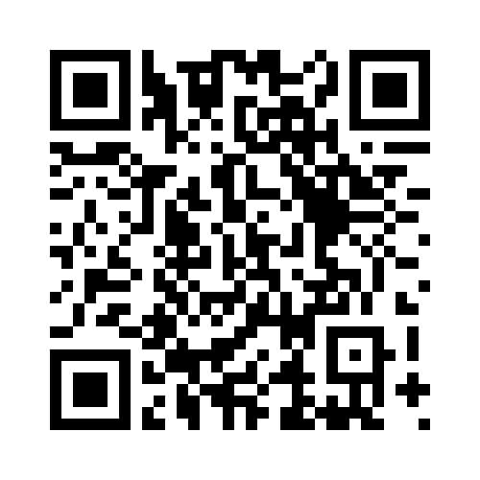
Please Complete An Evaluation Form Your input is important!
or

