Slide 2
Adding Power BI Data Experiences to Your Applications
B804
Josh Caplan & Lukasz Pawlowski
Senior Program Managers Microsoft Power BI

Slide 3

What if your app could put the power of analytics everywhere decisions are made?
Modern apps with data visualizations built-in have the power to inform decisions in context—
for any user on any device

Slide 4

Announcing
Microsoft Power BI Embedded preview
An Azure service for Power BI

Slide 5
You have the app. You have the data.
Bring data to life inside your app with Power BI Embedded
Create compelling interactive reports
Embed easily for
faster time to value
Deploy quickly
and manage with ease

Slide 6

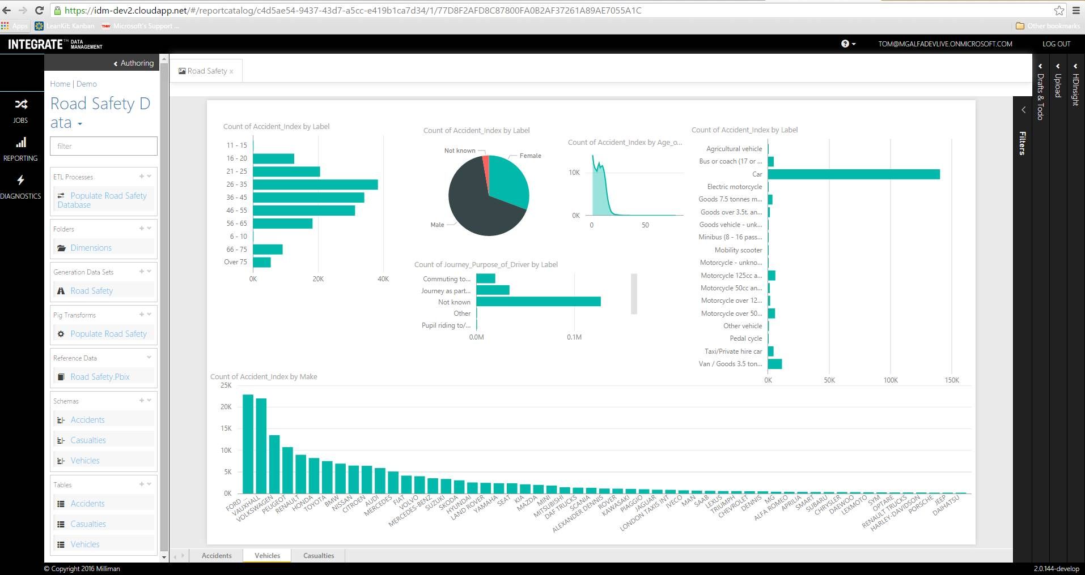
Demo
Power BI Embedded

Slide 7

Power BI Embedded Conceptual Model
1,N
Microsoft Azure
subscription
Developer
1,N
Workspace collection
Name
Admin Users
Endpoints
Keys
Gateways
Credentials
Geo Location
Tags
Azure SQL Database
Azure SQL
Data Warehouse
1,N
on Azure HDInsight
Workspace
Name
Reports
Datasets
Tags
Embed
Your app
End users

Slide 8

Create compelling interactive reports that are always up to date
Author interactive reports without
writing any code
Choose modern visualizations
out-of-the-box or customize
without building them from scratch
Visualize any data from a variety
of cloud sources
Keep your data always-up-to-date
with DirectQuery
Create
Embed
Deploy

Slide 9
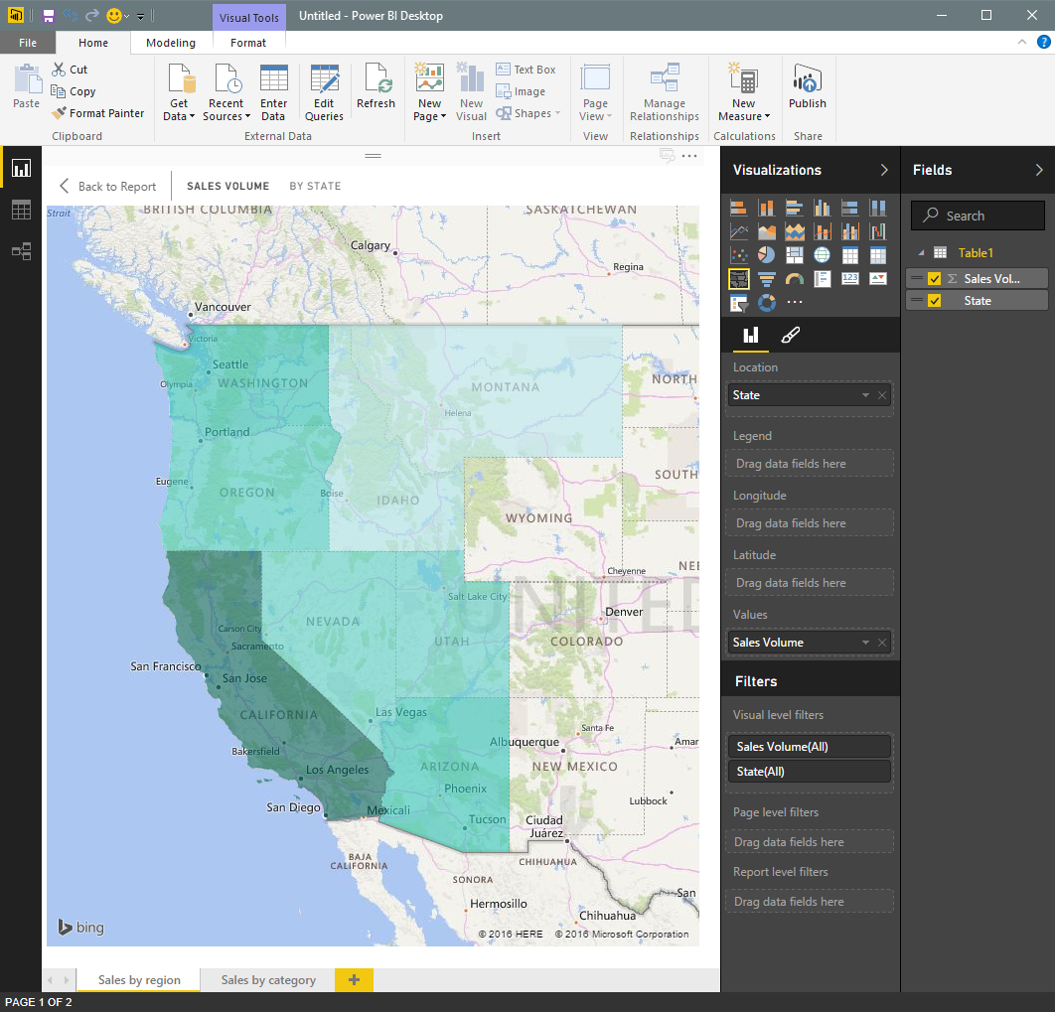
Easily author interactive reports for free in
Power BI Desktop
Shape data into the format and structure you need
Produce rich data models using formulas and relationships
Explore data through a freeform, drag-and-drop canvas
Publish interactive data visualizations to your app
Create
Embed
Deploy

Slide 10
Keep visuals up to date using DirectQuery
Azure SQL Database
Connect directly to the source without moving your data
Build visualizations over
very large datasets
Azure SQL
Data Warehouse
Power BI report
Your app
on Azure HDInsight
Create
Embed
Deploy

Slide 11
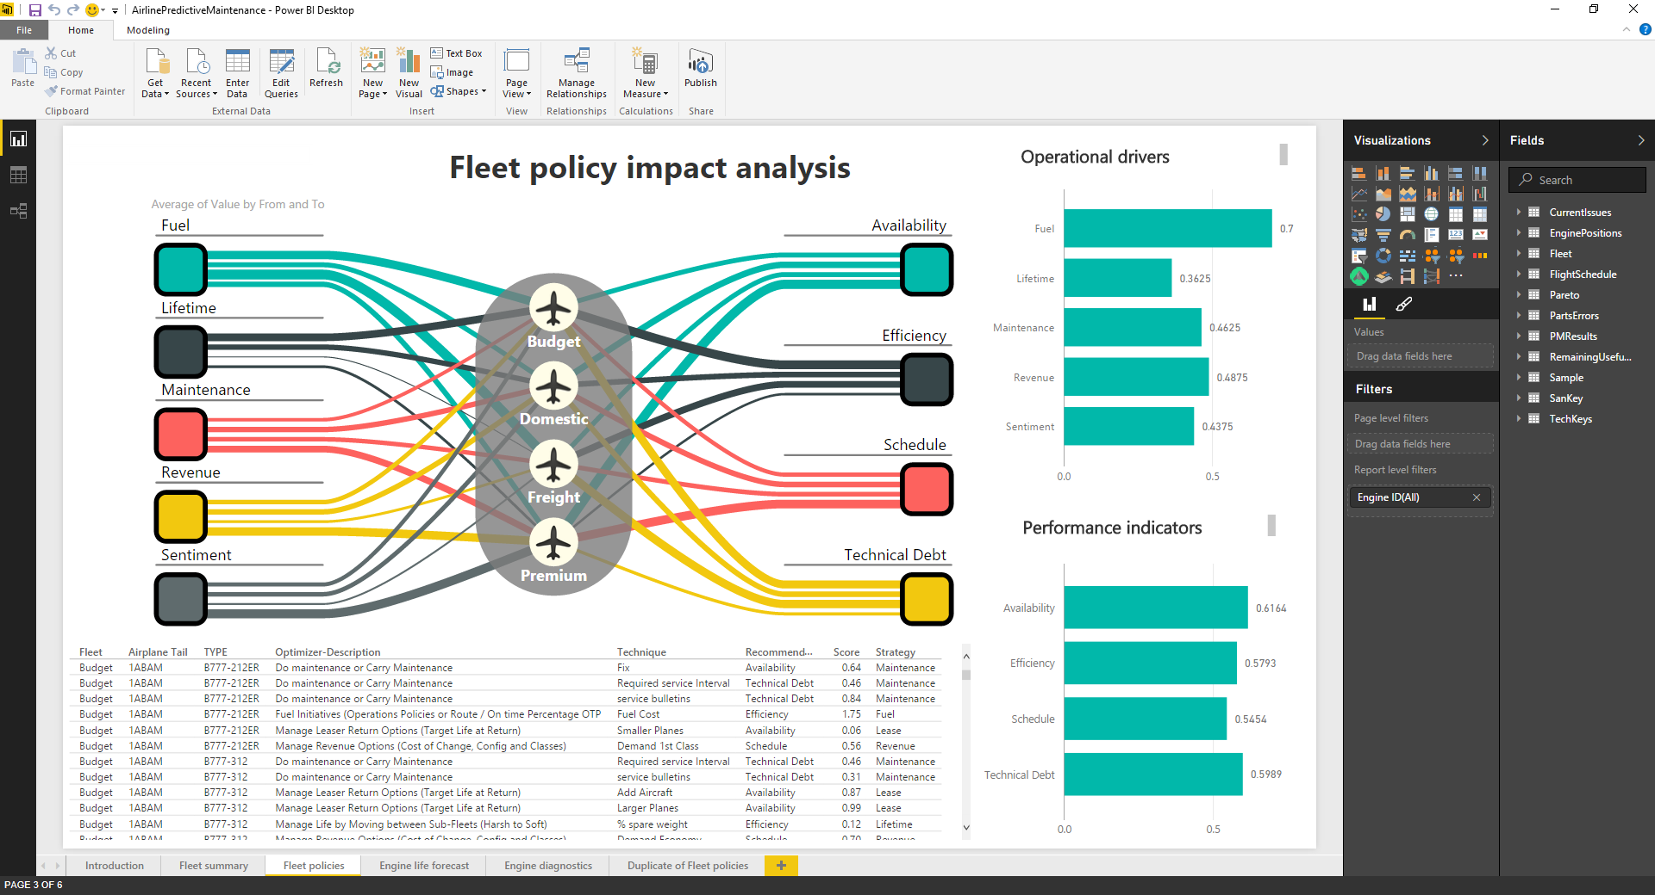
Demo
Create Reports

Slide 12
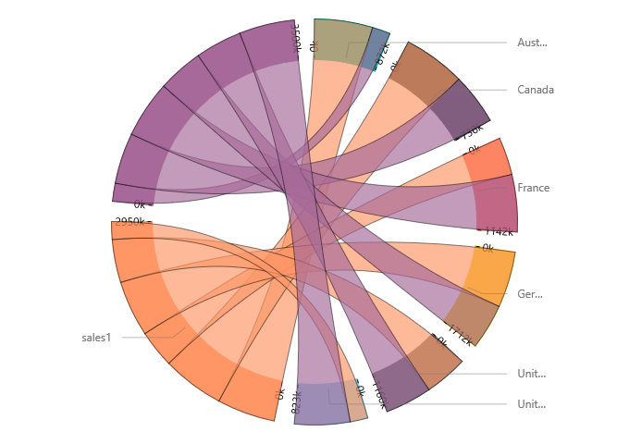
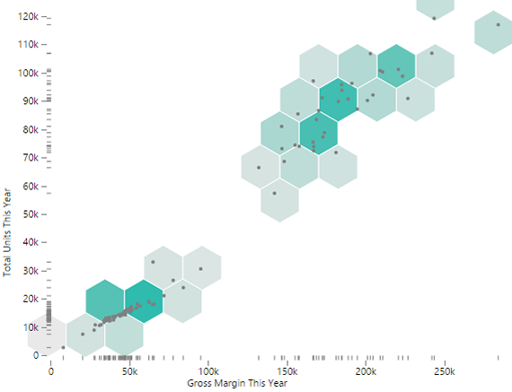
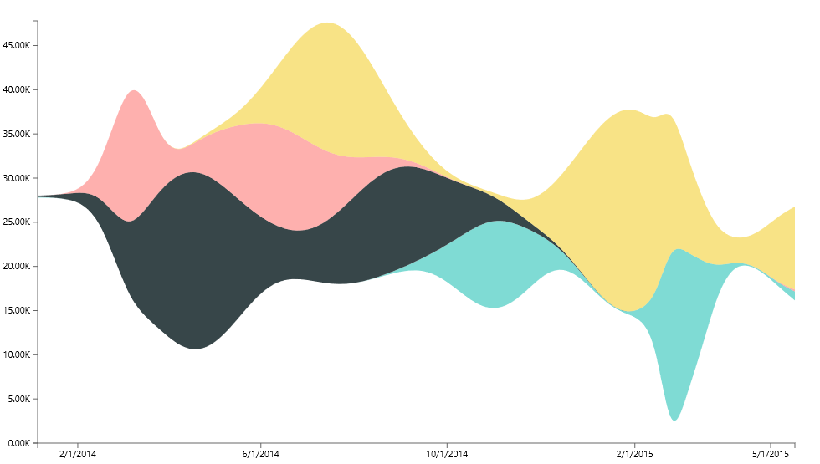
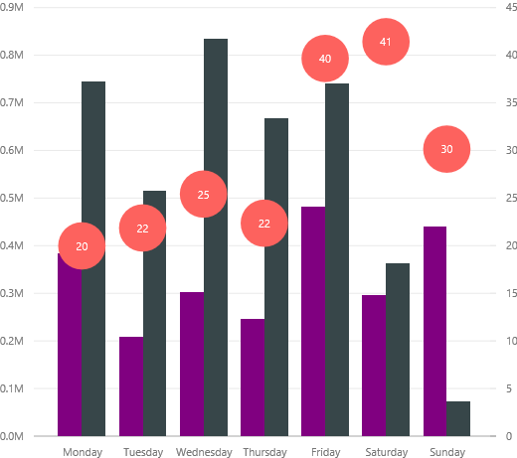
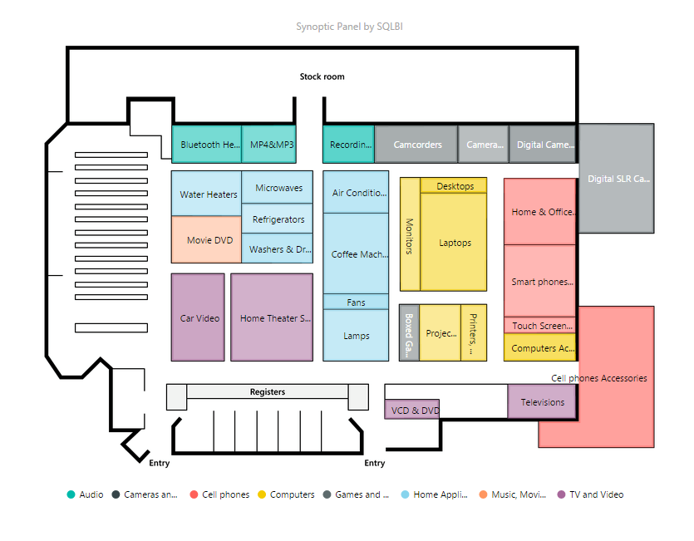
Get started quickly with Microsoft’s open-sourced, production-quality visualization code
Leverage the visualization framework, test suite and tooling to build the right
custom visuals for your app
Create
Embed
Deploy

Slide 13

Demo
Visualize data your way

Slide 14

Embed data experiences easily on any device for immediate value
Easily embed interactive visuals in your app using REST APIs and the Power BI SDK
Ensure consistent high-fidelity data experiences across any device
Provide friction-free authentication and authorization experiences
Realize faster time-to-value without redesigning your app
Create
Embed
Deploy

Slide 15
Power BI Embedded API surface
Your app
Power BI APIs
Discovery: Enumerate datasets and reports
Content Creation: Provision datasets and reports
Embed: Embed reports
Utility: Set connection strings and credentials
Programmatic
REST APIs
Azure Resource Manager API
Azure APIs for automation
Microsoft Azure
Power BI Embedded
Platform
Provision workspace collections
De-provision workspace collections
Manage API keys
Azure SQL
Database
Azure SQL
Data Warehouse
Spark on
Azure HDInsight
Data
Create
Embed
Deploy

Slide 16
Power BI APIs

Slide 17
Addressing the APIs
Https://
API.PowerBI.com
Beta
collections
{Workspace Collection Name}
https://api.powerbi.com/beta/collections/{workspace collection name}/

Slide 18
Workspace
https://api.powerbi.com/beta/collections/{workspace collection name}/workspaces…

Slide 19
Import API
https://api.powerbi.com/beta/collections/{workspace collection name}/workspaces/{workspace id}/imports…

Slide 20
Available APIs
Datasets
Reports
https://api.powerbi.com/beta/collections/{workspace collection name}/workspaces/{workspace id}/datasets…
https://api.powerbi.com/beta/collections/{workspace collection name}/workspaces/{workspace id}/reports…

Slide 21
Embed
// find the iFrame on the page and handle the loaded event.
var iframe = document.getElementById('iFrameEmbedReport');
iframe.src = embedReportUrl;
iframe.onload = postActionLoadReport;
// post the access token to the iFrame to load the tile
function postActionLoadReport() {
// get the app token.
accessToken = {generate app token};
// construct the push message structure
var m = { action: "loadReport", accessToken: accessToken};
message = JSON.stringify(m);
// push the message.
iframe = document.getElementById('iFrameEmbedReport');
iframe.contentWindow.postMessage(message, "*");
}

Slide 22
App Tokens

Slide 23
App Tokens
Application
AuthN
AuthZ
Power BI
Workspace Collection

Slide 24
Provide seamless authentication experiences
Application
Power BI
Users
Workspace
Auth. providers
Token
+ Claim: Can view Report 1
+ Expiration: 5 minutes
Report 1
Permissions
Report 2
Sign token
API keys
API keys
Copy API keys to your application
Create
Embed
Deploy

Slide 25
Provide seamless authentication experiences
Application
Power BI
User requests to view Report 1
Users
Workspace
Auth. providers
Token
+ Claim: Can view Report 1
+ Expiration: 5 minutes
Report 1
Permissions
Report 2
Validate token
API keys
API keys
Create
Embed
Deploy

Slide 26
Provide seamless authentication experiences
Application
Power BI
Users
Workspace
Auth. providers
Report 1
Report 1
Permissions
Report 2
API keys
API keys
Create
Embed
Deploy

Slide 27

Deploy quickly at cloud scale while managing costs and resources
Automate deployment via Power BI
and Azure Resource Management APIs
Automatically scale as your app grows
Pay as you go with consumption-based pricing
Create
Embed
Deploy

Slide 28
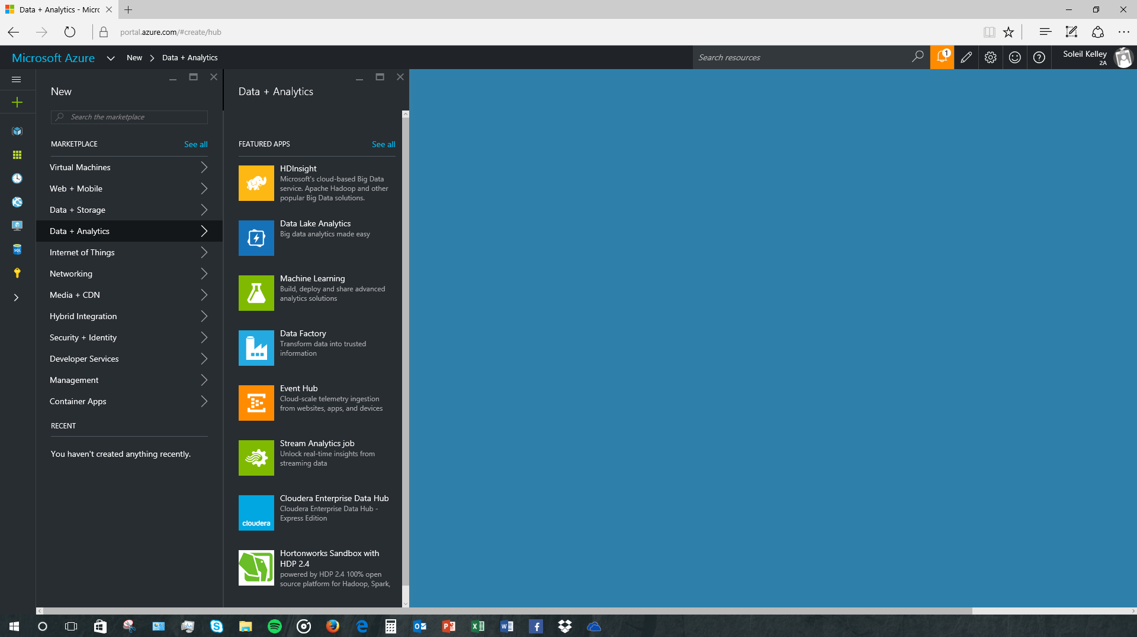

Demo
E2E Getting Started
Power BI
Add Power BI reports and datasets to your application

Slide 29
Change the game with the complete array of Azure Services
Your app
Azure services
Data and storage
Analytics
Internet
of things
Access management
SQL DB
Document DB
Blob Storage
StorSimple
SQL Data
Warehouse
Power BI
Embedded
Data Lake Analytics
Data Lake Store
HDInsight
Stream Analytics
IoT Hub
Event Hubs
Machine Learning
Notification Hubs
Azure Active Directory
Multi-factor authentication
Create
Embed
Deploy

Slide 30
Control costs with pay-as-you-go, render-based pricing
Price per render, per month
0-1000 | Free
1000+ | $2.50/1k renders
Author interactive reports in
Power BI Desktop for free
Enjoy simple pricing with no upfront costs, hidden maintenance fees or customization charges
What is one render?
  When a Power BI visualization displayed and it queries your data
Query
Your data
Your users
Cache
Create
Embed
Deploy

Slide 31
Get started for free, today
dev.PowerBI.com

Slide 32
Developer resources
Home page
https://azure.microsoft.com/services/power-bi-embedded
Developer center
http://dev.powerbi.com
Developer blog
  http://blogs.msdn.com/powerbidev
Samples
  http://github.com/PowerBI
Open source visuals
http://github.com/Microsoft/PowerBI-visuals
Visuals gallery
http://visuals.powerbi.com
Ask us questions
http://stackoverflow.com/questions/tagged/powerbi

Slide 33
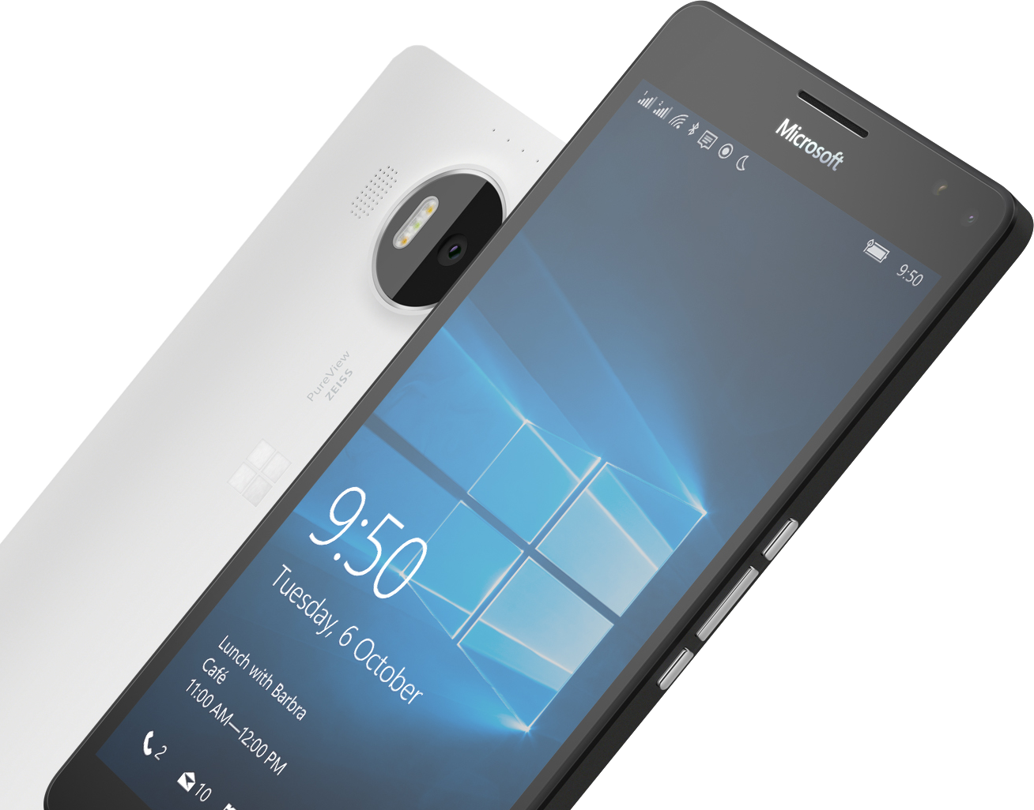


Please Complete An Evaluation Form
Your input is important!
Required Slide
*delete this box when your slide is finalized
or

