Slide 1
.NET Debugging for the Production Environment
Part 2: Using Perfmon to diagnose application issues
Brad Linscott
Premier Field Engineering

Slide 2
Understanding Perfmon Counters
Perfmon: high-level overview
Objects, Counters, & Instances! Oh my!
One approach to analyzing counters
Counters for cpu issues
Counters for memory issues
Counters for ASP.Net issues
Counters for managed exceptions

Slide 3
Perfmon: High-level overview
Baked-in tool that monitors the OS and/or processes for a myriad of performance statistics.
Also called Performance Monitor, System Monitor, and Sysmon (tip for searches).
Poor at identifying root cause; excellent at defining the problem.
Obtaining a problem definition: A key first step of troubleshooting!
Notes:
Perfmon can collect a vast amount of data produced by the operating system. The data is constantly being produced – Perfmon simply captures it.
Perfmon data can represent the entire computer or it can be as specific as a particular aspect of a particular process. You add what you want to see. The counters discussed in this slide deck are of particular interest to diagnosing issues with .NET applications.
Perfmon (short for ‘Performance Monitor’) is also sometimes referred to as System Monitor or Sysmon. Although Perfmon & Sysmon are two different things (Perfmon is actually part of Sysmon), when you’re searching online for anything Perfmon-related, you sometimes have to search for ‘System Monitor’ or ‘Sysmon’ instead of ‘Perfmon’.

Slide 4
Perfmon: High-level overview (cont’d)
Perfmon vs Task Manager
Perfmon provides more detail
Perfmon provides trends
Notes:
Task Manager is convenient and a great tool to determine certain aspects of the computer or a specific process at a given point in time. However, it does not provide trends or cover any length of time. And in general, it does not provide the breadth of information collected by Perfmon.
For many/most application performance problems, Perfmon is preferred over TaskManager to track and diagnose performance issues.

Slide 5
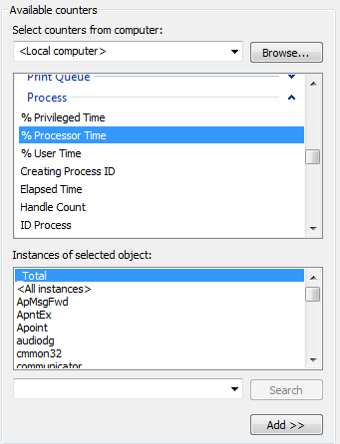
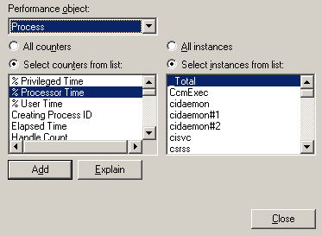
Objects, Counters, & Instances! Oh, my!
Perfmon data broken down into objects, counters, and sometimes instances.
Objects contain Counters
Counters may/may not
contain instances.
WS03 and
below
Vista and
beyond

Slide 6
Objects, Counters, & Instances, cont’d.
An Object relates to a specific aspect of the OS, processes, or a technology – e.g., System, Process, ASP.Net Apps objects.
Counters measure a specific metric – e.g.,
Amt. of memory in paged pool
# handles opened by a given process
Instances exist if the Object allows for it:
PagedPoolBytes counter covers entire computer; no Instances are possible
HandleCount counter can be measured by each process; an Instance is each process.exe.

Slide 7
One Approach to Perfmon Analysis
Problem definitions can be vague or specific; Perfmon can help support or oppose
Can be as vague as “app is broken”
Can be as specific as “hung process due to msgbox thrown in response to unhandled exception”
If problem definition is vague, use Perfmon to formulate a specific one
If problem definition is specific, use Perfmon to provide data which supports or opposes
Notes:
As we all know, problem definitions can be vauge or specific. One approach to Perfmon analysis is to leverage the data it collects to formulate a problem definition, support/disprove an existing problem definition, or to gain additional insight into an existing problem.
DO NOT TELL THE STORY ABOUT THE HIGH CPU HANG YET. Save that for the cpu counters slide.

Slide 8
One approach to Perfmon analysis (cont’d)
Great “handbook” for analyzing Perfmon counters to diagnose .NET performance issues:
ASP.NET Performance Monitoring, and When to Alert Administrators
http://msdn.microsoft.com/en-us/library/ms972959.aspx

Slide 9
Counters for CPU issues
Process object
%ProcessorTime counter – overall usage
%PrivilegedTime counter – kernel usage
%UserTime counter – user mode usage
Check %ProcessorTime first, then move onto the other counters
Note trends (rising, falling, flatlining, spiking, etc.)

Slide 10
Counters for memory issues
Process issues (e.g., VA space) vs system issues (e.g., pools, RAM)
Process object
Private Bytes
Virtual Bytes
Handle Count
.NET CLR Memory object
# Bytes in all Heaps
Gen 0, 1, 2 Heap Size
Gen0 counter measures budget, not commit
LOH Size
Notes:
http://msdn.microsoft.com/en-us/library/ms972959.aspx:
Private Bytes. The current size, in bytes, of the committed memory owned by this process. Memory leaks are identified by a consistent and prolonged increase in Private Bytes. This is the best performance counter for detecting memory leaks. When running on IIS 6.0, the memory limit should be set in IIS Manager. Open Properties for the application pool, and on the Recycling tab, specify a limit for Maximum used memory (in megabytes). This limit corresponds to Private Bytes. Private Bytes for the worker process is compared with the memory limit to determine when to recycle the process. System.Web.Caching.Cache also uses Private Bytes and the memory limit to determine when to expunge items from the cache, and thus avoid recycling the process. A memory limit of 60% of physical RAM is recommended to avoid paging, especially when a new process replaces the old one due to excessive memory consumption.
It is important to adjust the memory limit on machines with large amounts of physical RAM, so that the cache memory manager and process recycling function properly. For example, assume you have a server with 4 gigabytes (GB) of physical RAM that is using the default memory limit. This is a problem. Sixty percent of physical RAM is 2.4 GB, which is larger than the default virtual address space of 2 GB. So what should the memory limit be set to?
There are a couple things to consider: First, the likelihood of experiencing an OutOfMemoryException begins to increase dramatically when "Process\Virtual Bytes" is within 600 MB of the virtual address space limit (generally 2 GB), and secondly, tests have shown that "Process\Virtual Bytes" is often larger than "Process\Private Bytes" by no more than 600 MB. This difference is due in part to the MEM_RESERVE regions maintained by the GC, allowing it to quickly commit more memory when needed. Taken together this implies that when "Process\Private Bytes" exceeds 800 MB, the likelihood of experiencing an OutOfMemoryException increases. In this example the machine has 4 GB of physical RAM, so you need to set the memory limit to 20% to avoid out-of-memory conditions. You might experiment with these numbers to maximize the usage of memory on a machine, but if you want to play it safe, the numbers in the example will work.
To summarize, set the memory limit to the smaller of 60% of physical RAM or 800 MB. Since v1.1 supports 3 GB virtual address space, if you add /3GB to boot.ini, you can safely use 1,800 MB instead of 800 MB as an upper bound.
# Bytes in all Heaps. The number of bytes committed by managed objects. This is the sum of the perfmon counters LOH Size and the Generation 0, 1, and 2 heap size counters. These regions of memory are of type MEM_COMMIT (see Platform SDK documentation for VirtualAlloc). The value of this counter will always be less than the value of Process\Private Bytes, which counts all MEM_COMMIT regions for the process. Private Bytes minus # Bytes in all Heaps is the number of bytes committed by unmanaged objects. The first step in the investigation of excessive memory usage is to determine whether it is being used by managed or unmanaged objects.

Slide 11
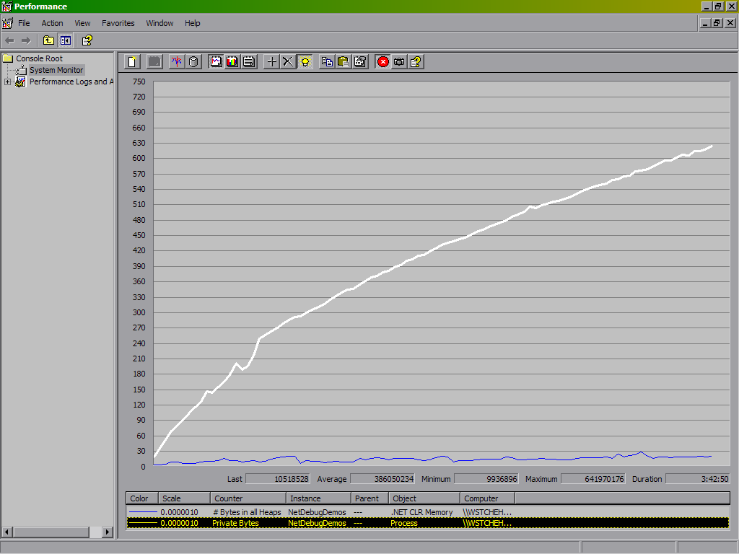
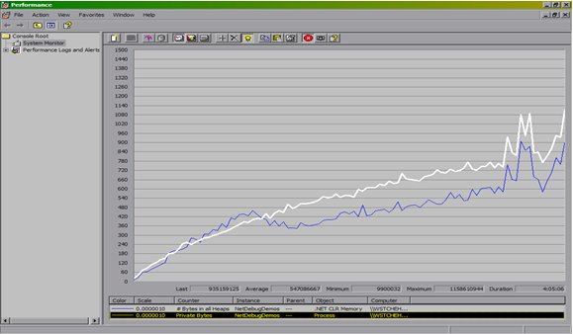
Counters for memory issues, cont’d
Unmanaged Leak
Managed “Leak”
White line: Private Bytes
Blue line: # Bytes in all Heaps

Slide 12
Counters for ASP.NET issues
ASP.NET object
Application Restarts
Requests Queued
Process object
ID Process
ASP.NET Applications object
Request Execution Time
Request Wait Time
Requests Disconnected
Requests Executing
Requests Failed
Requests In App Queue
Requests Succeeded
Requests Timed Out
Requests/sec
For more information, see
http://msdn.microsoft.com/en-us/library/ms998579.aspx#scalenetchapt15_topic12
Notes:
From http://msdn.microsoft.com/en-us/library/ms972959.aspx:
Application Restarts. The number of application restarts. Recreating the application domain and recompiling pages takes time, therefore unforeseen application restarts should be investigated. The application domain is unloaded when one of the following occurs:
Modification of machine.config, web.config, or global.asax.
Modification of the application's bin directory or its contents.
When the number of compilations (ASPX, ASCX, or ASAX) exceeds the limit specified by <compilation numRecompilesBeforeAppRestart=/>.
Modification of the physical path of a virtual directory.
Modification of the code-access security policy.
The Web service is restarted.
Threshold: 0. In a perfect world, the application domain will survive for the life of the process. Excessive values should be investigated, and a new threshold should be set as necessary.
Requests Queued. The number of requests currently queued. When running on IIS 6.0, there is a queue where requests are posted to the managed ThreadPool from native code, and a queue for each virtual directory. This counter includes requests in all queues. The queue between inetinfo and aspnet_wp is a named pipe through which the request is sent from one process to the other. The number of requests in this queue increases if there is a shortage of available I/O threads in the aspnet_wp process. On IIS 6.0 it increases when there are incoming requests and a shortage of worker threads. Note that requests are rejected when the Requests Current counter exceeds the <processModel requestQueueLimit=/>. Many people think this occurs when the Requests Queued counter exceeds requestQueueLimit, but this is not the case. When this limit is exceeded, requests will be rejected with a 503 status code and the message "Server is too busy." If a request is rejected for this reason, it will never reach managed code, and error handlers will not be notified. Normally this is only an issue when the server is under a very heavy load, although a "burst" load every hour might also cause this.
Each virtual directory has a queue that it uses to maintain the availability of worker and I/O threads. The number of requests in this queue increases if the number of available worker threads or available I/O threads falls below the limit specified by <httpRuntime minFreeThreads=/>. When the limit specified by <httpRuntime appRequestQueueLimit=/> is exceeded, the request is rejected with a 503 status code and the client receives an HttpException with the message "Server too busy."
By itself, this counter is not a clear indicator of performance issues, nor can it be used to determine when requests will be rejected.
Requests Executing. The number of requests currently executing. This counter is incremented when the HttpRuntime begins to process the request and is decremented after the HttpRuntime finishes the request.
Requests In Application Queue. The number of requests in the application request queue (see description of Requests Queued above). In addition to Requests Current, Requests in Application Queue provides a warning for when requests will be rejected. If there are only a couple virtual directories, increasing the default appRequestQueueLimit to 200 or 300 may be suitable, especially for slow applications under heavy load.
Requests/Sec. The number of requests executed per second. I prefer "Web Service\ISAPI Extension Requests/sec" because it is not affected by application restarts.
For more information on these and other counters, see the Patterns & Practices guide on Improving .NET Application Performance & Scalability, chapter 15 (link included on this side) or the whitepaper noted earlier entitled “ASP.NET Performance Monitoring, and When to Alert Administrators”.

Slide 13
Counters for .NET Exceptions
.NET CLR Exceptions object
# Exceptions Thrown
# Exceptions Thrown/sec
Notes:
Based on my experience, performance (as measured by increased cpu, increased memory footprint, and/or slower throughput) takes a noticeable hit once #Exceptions Thrown/sec reaches around 15 or so. The ideal number here is 0 in adherence with best practices. However, if the number can be kept in the single digits, that will keep the perf hit to a minimum.

